Slide 1


Intelligent Engineering with AI
Welcome to the second day
Learn to elevate your software engineering practices by integrating Test-Driven Development (TDD) with cutting-edge AI tools like GitHub Copilot and ChatGPT.
Notes:
(8:30 – 9:00) Breakfast
Open time just to have students mingle and instructors organize.

Slide 2

Recap of Day 1
TDD cycle: Red, Green, Refactor
Katas:
Fizz Buzz
Duration Converter
Bowling Kata
Roman Numeral Calculator
SOLID, ZOMBIES, Extreme Programming, DRY, YAGNI
Integration of AI tools like GitHub Copilot and ChatGPT
Notes:
(9:00 - 9:20) 20 minutes
**One Sentence Summary**
- "Begin with a recap of Day 1, highlighting the key concepts covered and addressing any lingering questions."
**Detailed Notes**:
- **TDD Cycle: Red, Green, Refactor**:
- **Explanation**:
- Recap the TDD cycle and its importance in ensuring code correctness and maintainability.
- **Example**:
- "Remember how we used the Red, Green, Refactor cycle in the Fizz Buzz Kata to iteratively develop and improve our code."
- **Fizz Buzz Kata, Roman Numeral Calculator Kata, Bowling Kata**:
- **Explanation**:
- Highlight the katas practiced on Day 1 and their role in reinforcing TDD principles.
- **Example**:
- "We tackled the Fizz Buzz Kata to understand basic TDD, and then moved on to the Roman Numeral Calculator and Bowling Kata for more complex scenarios."
- **Refactoring Techniques, Clean Code Principles, and Design Patterns**:
- **Explanation**:
- Summarize the importance of refactoring, clean code principles, and design patterns discussed on Day 1.
- **Example**:
- "We explored various refactoring techniques to improve code readability and maintainability, along with key design patterns to structure our code effectively."
- **Integration of AI Tools like GitHub Copilot and ChatGPT**:
- **Explanation**:
- Recap how AI tools were integrated into the exercises to enhance productivity and learning.
- **Example**:
- "We used GitHub Copilot to generate code snippets and ChatGPT to provide explanations and suggestions, making our development process more efficient."
- **Key Takeaways and Address Any Questions from Day 1**:
- **Explanation**:
- Encourage participants to share their key takeaways and address any questions or clarifications needed.
- **Example**:
- "Let's take a few minutes to discuss any questions you might have from yesterday. What were your key takeaways, and is there anything you'd like to revisit?"
**Background Information**:
- **Day 1 Recap**:
- Revisiting the concepts covered on Day 1 helps reinforce learning and ensures participants are on the same page.
- Encouraging questions and discussions fosters a collaborative learning environment and addresses any uncertainties.
**Example**:
- **Real-world Scenario**:
- "Yesterday, we successfully applied TDD to various katas, which helped us understand the iterative development process. By integrating AI tools, we were able to enhance our coding efficiency and gain deeper insights into best practices."

Slide 3

Overview of Day 2 Morning Objectives
Identifying and addressing code smells
Gilded Rose Kata
Design patterns
Notes:
(9:20 - 9:30) 10 minutes
**One Sentence Summary**
- "Outline the objectives and focus areas for Day 2, setting the stage for the topics and exercises we will cover in the morning session."
**Detailed Notes**:
- **Focus Areas for the Morning Session**:
- **Gilded Rose Kata as the Main Hands-On Exercise**:
- **Explanation**:
- Introduce the Gilded Rose Kata as the primary exercise for the morning, emphasizing its role in practicing TDD and refactoring techniques.
- **Example**:
- "We'll spend a significant portion of the morning session working on the Gilded Rose Kata, which will help us refine our TDD skills and practice maintaining and refactoring legacy code."
- **Identifying and Addressing Code Smells**:
- **Explanation**:
- Discuss the importance of recognizing and addressing common code smells to improve code quality.
- **Example**:
- "We'll learn to identify various code smells and understand how to refactor them, ensuring our codebase remains clean and maintainable."
- **Applying Design Patterns**:
- **Explanation**:
- Highlight the role of design patterns in creating scalable and maintainable code.
- **Example**:
- "We'll explore several common design patterns and see how they can be applied to solve recurring design problems in software development."
- **Using AI Tools Effectively**:
- **Explanation**:
- Emphasize the continued use of AI tools like GitHub Copilot and ChatGPT to enhance productivity and learning.
- **Example**:
- "We'll continue leveraging AI tools to assist us in coding, testing, and refactoring, making our development process more efficient."
**Background Information**:
- **Day 2 Objectives**:
- Clearly outlining the goals for the day helps set expectations and prepares participants for the upcoming activities.
- Emphasizing the focus areas ensures participants understand the relevance of each topic and how it builds on what was covered on Day 1.
**Example**:
- **Real-world Scenario**:
- "Today, we'll dive deeper into TDD and refactoring with the Gilded Rose Kata, learn to identify and address common code smells, and explore design patterns that help us write better software. By continuing to use AI tools, we'll enhance our productivity and streamline our development process."

Slide 4

Introduction to Code Smells
Definition of code smells
Importance of identifying and addressing code smells for maintainable code
Notes:
(9:30 - 9:35) 5 minutes
**One Sentence Summary**
- "Introduce the concept of code smells, explaining their importance and how identifying and addressing them leads to more maintainable code."
**Detailed Notes**:
- **Definition of Code Smells**:
- **Explanation**:
- Code smells are indicators of potential problems in the code that may not be bugs but suggest a need for refactoring.
- **Example**:
- "A code smell is a surface indication that usually corresponds to a deeper problem in the system. It could be a sign of poor design choices or areas that need refactoring."
- **Importance of Identifying and Addressing Code Smells for Maintainable Code**:
- **Explanation**:
- Addressing code smells helps maintain code quality and prevent technical debt. Regularly refactoring to remove code smells ensures the codebase remains clean, readable, and maintainable.
- **Example**:
- "Ignoring code smells can lead to increased technical debt, making the code harder to understand and modify. By addressing these smells early, we keep our codebase healthy and easier to maintain."
**Background Information**:
- **Code Smells**:
- The term "code smell" was popularized by Martin Fowler in his book "Refactoring: Improving the Design of Existing Code." It's a metaphor for any symptom in the source code that possibly indicates a deeper problem.
- Code smells are not bugs; they are not technically incorrect and do not prevent the program from functioning. Instead, they indicate weak spots in the code that may require improvement.
**Example**:
- **Real-world Scenario**:
- "In one of our previous projects, we encountered a method that had grown excessively long and complex over time. This long method was a code smell indicating that it needed to be broken down into smaller, more manageable pieces. By refactoring it, we improved the readability and maintainability of the code."

Slide 5

Long Methods and Large Classes
Long Methods
Methods that are too long and do too much
Large Classes
Classes with too many responsibilities
Notes:
(9:35 - 9:40) 5 minutes
**One Sentence Summary**
- "Discuss the code smells of long methods and large classes, explaining why they occur and how to refactor them for better maintainability."
**Detailed Notes**:
- **Long Methods**:
- **Explanation**:
- Long methods are methods that have grown too large and try to do too much. They can be difficult to understand, test, and maintain.
- **Example**:
- "A method that handles user input, performs validation, processes the data, and updates the database all in one can be considered a long method. It's trying to do too much and should be broken down into smaller, single-responsibility methods."
- **Refactoring Tips**:
- Extract Method: Break down the long method into smaller, more focused methods.
- Replace Method with Method Object: Convert the method into its own class to handle complex processes.
- **Large Classes**:
- **Explanation**:
- Large classes have too many responsibilities, making them difficult to understand, test, and maintain. They often result from classes taking on more roles than they should.
- **Example**:
- "A class that handles user authentication, manages user profiles, and processes user payments is a large class. It has too many responsibilities and should be broken down into smaller, more focused classes."
- **Refactoring Tips**:
- Extract Class: Create new classes and move related fields and methods to these new classes.
- Extract Interface: Define interfaces for different responsibilities and implement them in separate classes.
**Background Information**:
- **Long Methods and Large Classes**:
- These are common code smells that indicate a violation of the Single Responsibility Principle (SRP) from the SOLID principles. Each method or class should have only one reason to change, focusing on a single responsibility.
**Example**:
- **Real-world Scenario**:
- "In a project for an e-commerce platform, we had a `CheckoutManager` class that handled everything from calculating totals to processing payments and sending confirmation emails. By refactoring, we extracted these responsibilities into separate classes like `PaymentProcessor` and `EmailNotifier`, which improved code readability and maintainability."

Slide 6
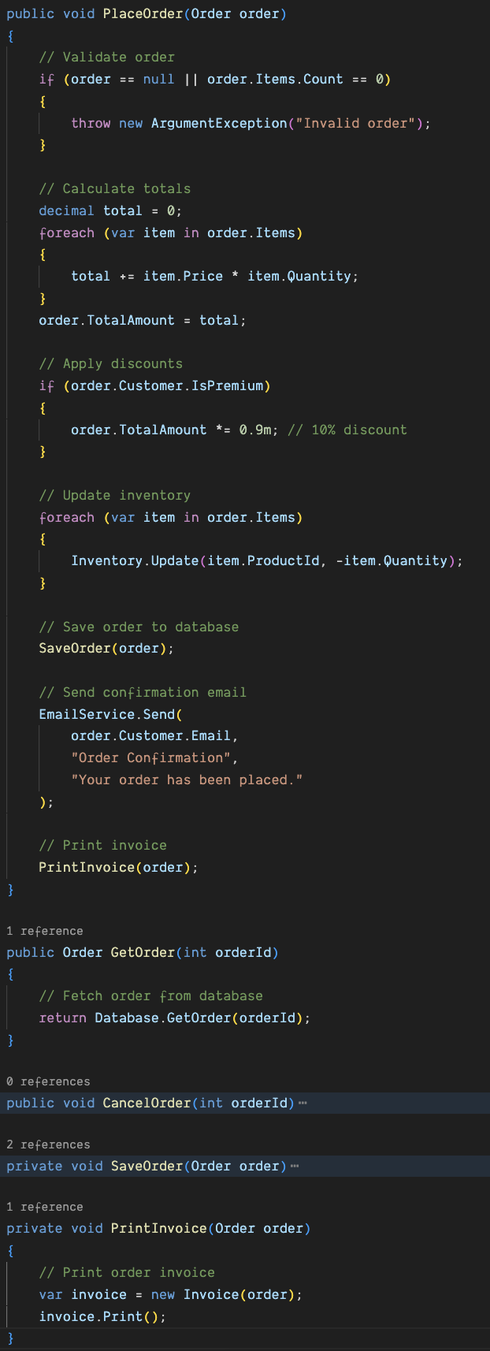
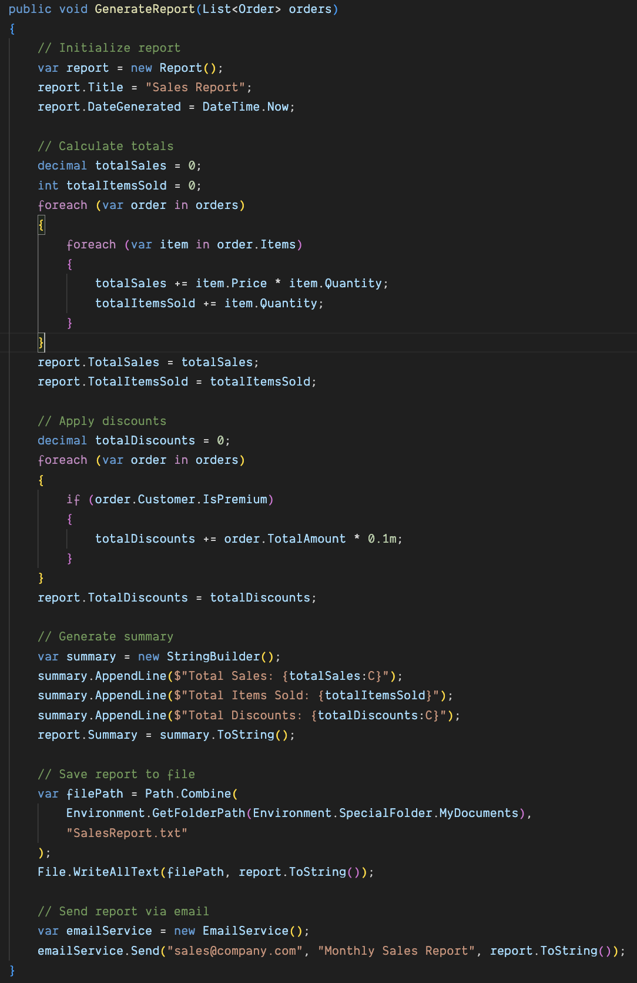
Long Methods and Large Classes
Notes:
## Example Long Method
In this example, the `GenerateReport` method performs multiple responsibilities:
- Initializes the report
- Calculates total sales and total items sold
- Applies discounts
- Generates a summary
- Saves the report to a file
- Sends the report via email
Each of these responsibilities can be extracted into separate methods to improve readability and maintainability.
## Example Large Class
In this example, the `OrderService` class handles multiple responsibilities:
- Placing orders
- Fetching orders
- Cancelling orders
- Validating orders
- Calculating totals
- Applying discounts
- Updating inventory
- Sending emails
- Printing invoices
This makes the class large and difficult to maintain. Responsibilities should be separated into smaller, more focused classes.

Slide 7

Duplicated Code and Feature Envy
Duplicated Code
Code that is repeated in multiple places
Feature Envy
A method that seems more interested in a class other than the one it is in
Notes:
(9:40 - 9:45) 5 minutes
**One Sentence Summary**
- "Explain the code smells of duplicated code and feature envy, highlighting their causes and how to refactor them for better code quality."
**Detailed Notes**:
- **Duplicated Code**:
- **Explanation**:
- Duplicated code occurs when the same or very similar code is found in multiple places within a codebase. It makes maintenance more difficult since changes need to be replicated everywhere the code appears.
- **Example**:
- "If the same validation logic is written in multiple methods, it is duplicated code. Each time the validation logic needs to change, it has to be updated in every place it appears."
- **Refactoring Tips**:
- Extract Method: Move the duplicated code into a single method that can be called from multiple places.
- Extract Class: If the duplicated code is more complex, consider creating a new class to encapsulate the logic.
- **Feature Envy**:
- **Explanation**:
- Feature envy occurs when a method in one class seems more interested in the data or methods of another class. This indicates that the method might be better placed in the class it envies.
- **Example**:
- "A method in the `Order` class that spends more time accessing the data and methods of the `Customer` class than its own is exhibiting feature envy. It should likely be moved to the `Customer` class."
- **Refactoring Tips**:
- Move Method: Shift the method to the class that contains the data it is most interested in.
- Extract Method: If only part of the method is showing feature envy, extract that part and move it to the appropriate class.
**Background Information**:
- **Duplicated Code and Feature Envy**:
- Duplicated code violates the DRY (Don't Repeat Yourself) principle, which states that every piece of knowledge should have a single, unambiguous, authoritative representation. Feature envy indicates poor encapsulation and often points to a need for better object-oriented design.
**Example**:
- **Real-world Scenario**:
- "In a customer management system, we found that the `Customer` and `Order` classes had duplicated address validation logic. By extracting this logic into a shared `AddressValidator` class, we eliminated duplication and improved maintainability. Additionally, a method calculating customer discounts was moved from the `Order` class to the `Customer` class to reduce feature envy."

Slide 8
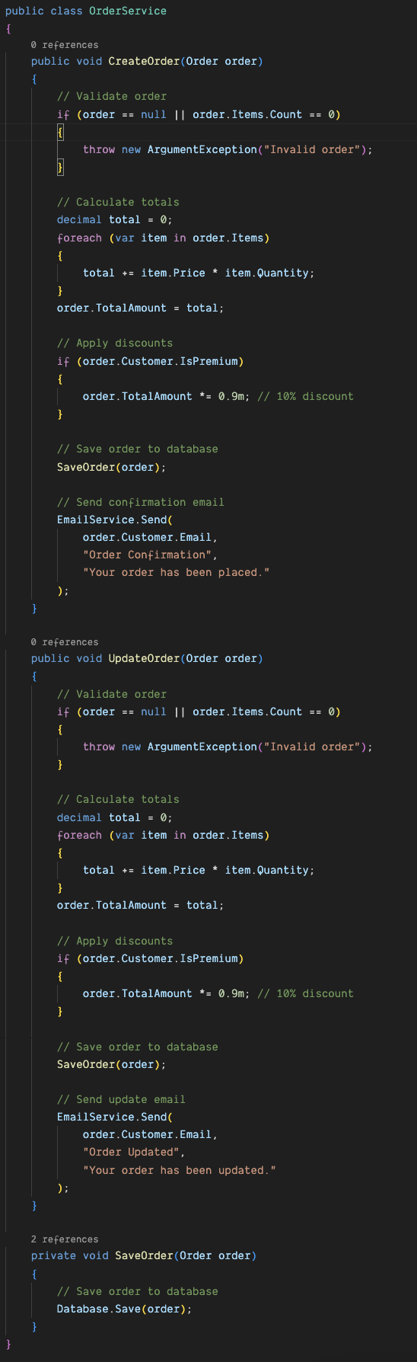
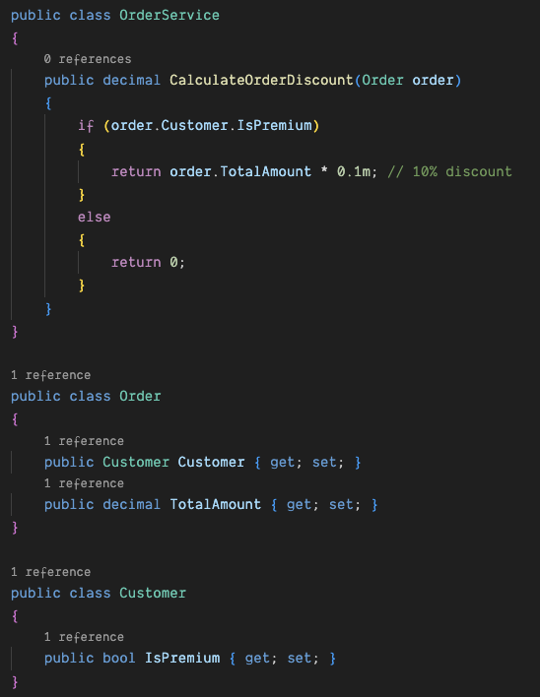
Duplicated Code and Feature Envy
Notes:
## Example of Duplicated Code
This example illustrates how the same logic is repeated in the `CreateOrder` and `UpdateOrder` methods, leading to duplicated code.
## Example of Feature Envy
In this example, the `OrderService` class has a method `CalculateOrderDiscount` that is more interested in the data of the `Order` and `Customer` classes. The method relies heavily on the `Order` class to access the `Customer` object and check if the customer is premium, as well as the `TotalAmount` property.
This is a classic example of Feature Envy because the `CalculateOrderDiscount` method could potentially belong to the `Order` class, where it has better access to the necessary data.

Slide 9

Data Clumps and Primitive Obsession
Data Clumps
Groups of data that always appear together
Primitive Obsession
Using primitive types instead of small objects for simple tasks
Notes:
(9:45 - 9:50) 5 minutes
**One Sentence Summary**
- "Discuss the code smells of data clumps and primitive obsession, explaining their impact on code quality and how to refactor them."
**Detailed Notes**:
- **Data Clumps**:
- **Explanation**:
- Data clumps occur when groups of data items frequently appear together in various parts of the code. This indicates that they should likely be encapsulated in their own class.
- **Example**:
- "If you often see `string firstName`, `string lastName`, and `DateTime dateOfBirth` appearing together in method signatures, it's a sign of a data clump. These fields should be encapsulated in a `Person` class."
- **Refactoring Tips**:
- Introduce Parameter Object: Create a new class that groups these related data fields together.
- Extract Class: Move the data clump to a new class that can be reused.
- **Primitive Obsession**:
- **Explanation**:
- Primitive obsession refers to the overuse of primitive data types to represent domain ideas, rather than using small objects. It can make the code less expressive and harder to maintain.
- **Example**:
- "Using a `string` to represent a currency amount or a `DateTime` to represent a duration is primitive obsession. These should be represented by more specific classes like `Money` or `Duration`."
- **Refactoring Tips**:
- Replace Data Value with Object: Create a class to represent the concept rather than using a primitive type.
- Use Value Objects: Encapsulate the primitive type within a value object that provides additional behavior.
**Background Information**:
- **Data Clumps and Primitive Obsession**:
- Data clumps can lead to code duplication and make the code harder to understand and maintain. Primitive obsession often leads to scattered logic and less cohesive classes. Both smells can be addressed by creating more meaningful abstractions.
**Example**:
- **Real-world Scenario**:
- "In a financial application, we had several methods that used multiple parameters for currency conversion, like `decimal amount`, `string currencyFrom`, and `string currencyTo`. We introduced a `CurrencyConversion` class to encapsulate these parameters, which simplified method signatures and improved readability. Similarly, we replaced primitive types representing monetary values with a `Money` class to handle currency-specific operations."

Slide 10
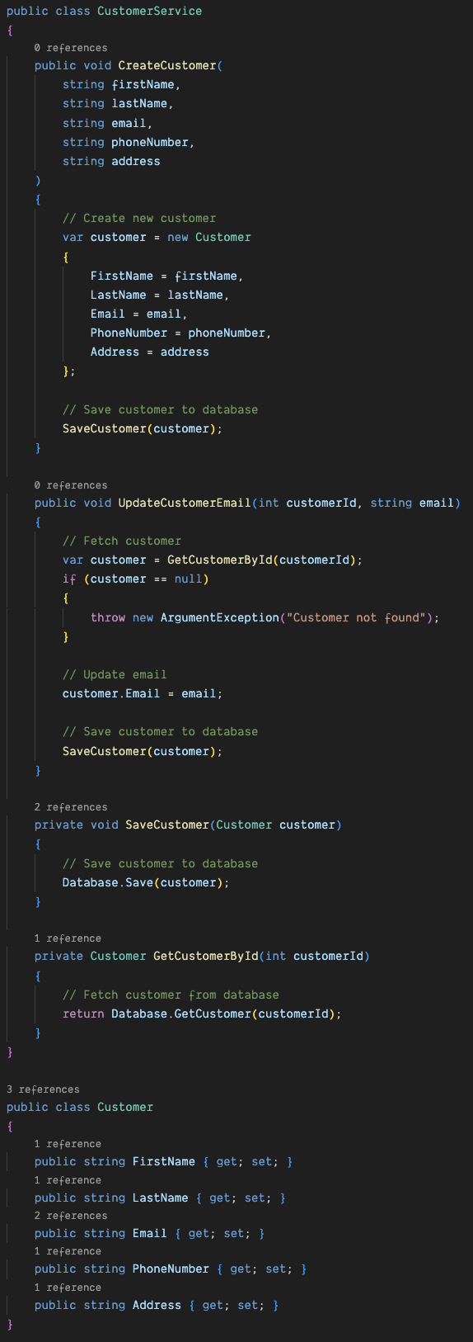
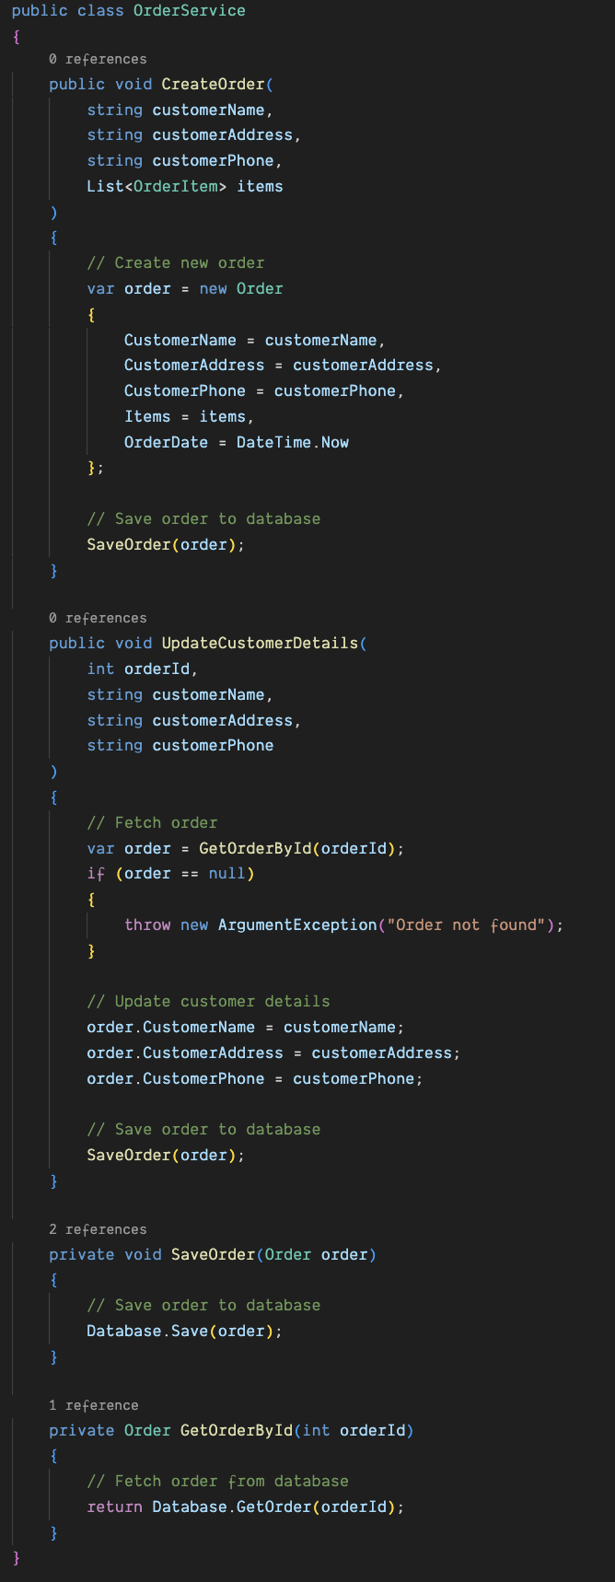
Data Clumps and Primitive Obsession
Notes:
## Example of Data Clumps
In this example, the `customerName`, `customerAddress`, and `customerPhone` parameters appear together in multiple methods (`CreateOrder` and `UpdateCustomerDetails`). These data clumps suggest that these parameters should be encapsulated in their own class, such as a `Customer` class, to improve code organization and maintainability.
## Example of Primitive Obsession
In this example, the `CustomerService` class uses primitive data types (`string` and `int`) for parameters and properties related to customer information. This is a form of Primitive Obsession because these primitives could be better represented by custom classes or value objects that encapsulate specific concepts.
For instance, instead of using `string` for email, phone number, and address, you could create custom classes such as `Email`, `PhoneNumber`, and `Address`. This would provide better encapsulation, validation, and clarity in the code.

Slide 11

Lazy Class and Speculative Generality
Lazy Class
A class that does too little
Speculative Generality
Code that is more abstract or generalized than necessary
Notes:
(9:50 - 9:55) 5 minutes
**One Sentence Summary**
- "Explore the code smells of lazy class and speculative generality, explaining their drawbacks and how to address them through refactoring."
**Detailed Notes**:
- **Lazy Class**:
- **Explanation**:
- A lazy class is one that isn't doing enough to justify its existence. It may have been necessary at some point but has since lost its purpose or was never fully implemented.
- **Example**:
- "A class that only contains a couple of methods or fields and doesn't have a significant role in the application can be considered a lazy class."
- **Refactoring Tips**:
- Inline Class: Move the responsibilities of the lazy class into another class and delete the lazy class.
- Combine with Another Class: If the lazy class has related responsibilities with another class, combine them into one.
- **Speculative Generality**:
- **Explanation**:
- Speculative generality is code that is more abstract or generalized than necessary, often created to anticipate future requirements that may never materialize.
- **Example**:
- "Creating a class hierarchy with multiple levels of inheritance for a simple task, in anticipation of future needs, is speculative generality."
- **Refactoring Tips**:
- Collapse Hierarchy: Simplify the class hierarchy by merging unnecessary subclasses.
- Remove Unused Code: Delete any unused abstractions or methods that were added for future needs that are not currently needed.
**Background Information**:
- **Lazy Class and Speculative Generality**:
- Lazy classes can contribute to a bloated codebase with unnecessary complexity. Speculative generality can make the code more difficult to understand and maintain, as it introduces unnecessary abstractions and complexity.
**Example**:
- **Real-world Scenario**:
- "In a project, we had a `Logger` class that only contained a single `Log` method. This class was identified as a lazy class, so we moved the `Log` method into a more relevant `Utility` class and deleted the `Logger` class. Similarly, we had a deeply nested class hierarchy for a feature that was not used, and we collapsed this hierarchy to simplify the codebase."

Slide 12
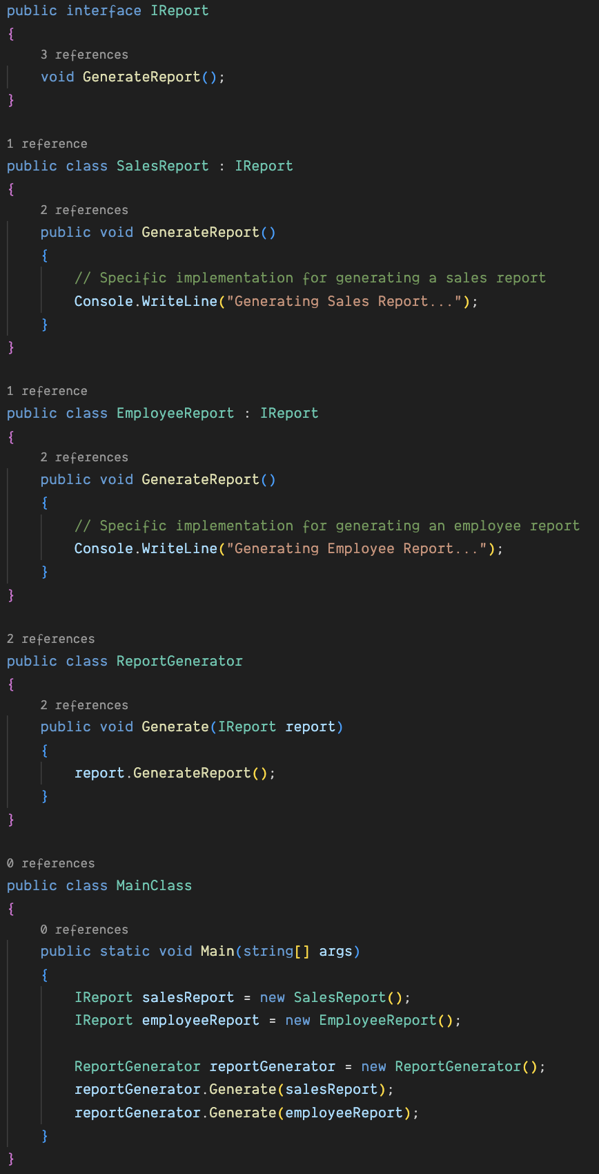
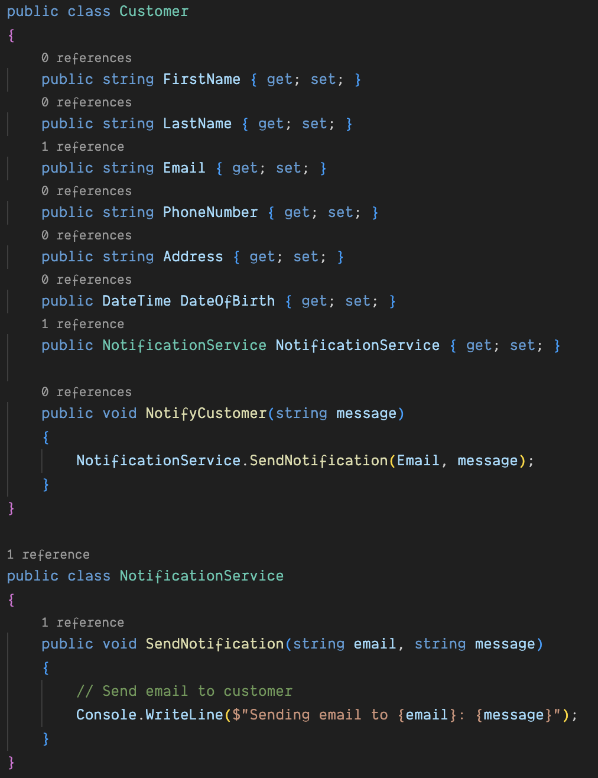
Lazy Class and Speculative Generality
Notes:
## Example of a Lazy Class
In this example, the `NotificationService` class is a Lazy Class. It contains only a single method, `SendNotification`, which does not have enough functionality to warrant its own class. This method could easily be integrated into the `Customer` class or another class that has more responsibility.
## Example of Speculative Generality
In this example, the `IReport` interface and the `ReportGenerator` class are examples of Speculative Generality. The design is overly abstract to handle multiple types of reports (SalesReport and EmployeeReport), even though there is no current requirement for this level of abstraction. This complexity adds unnecessary overhead without providing real benefits.
In a simpler design, the `SalesReport` and `EmployeeReport` classes could implement their own `GenerateReport` methods directly without an interface or a separate `ReportGenerator` class.
Would you like to move on to another code smell or explore a design pattern next?

Slide 13

Temporary Field and Other Code Smells
Temporary Field
An instance variable that is set only in certain situations
Other Common Code Smells
Comments as deodorant
Inappropriate intimacy
Notes:
(9:55 - 10:00) 5 minutes
**One Sentence Summary**
- "Highlight the code smells of temporary fields and other common issues, explaining their impact on code quality and how to address them."
**Detailed Notes**:
- **Temporary Field**:
- **Explanation**:
- A temporary field is an instance variable that is only set or used in certain situations, which can indicate poor class design or cohesion.
- **Example**:
- "An instance variable in a class that is only set for specific methods or under certain conditions can be considered a temporary field."
- **Refactoring Tips**:
- Extract Class: Move the temporary field and related behavior to a new class where it makes sense.
- Introduce Null Object: Use a Null Object pattern to handle the absence of values instead of conditional logic.
- **Other Common Code Smells**:
- **Comments as Deodorant**:
- **Explanation**:
- Using comments to explain complex code instead of refactoring the code to be self-explanatory.
- **Example**:
- "A method with many comments explaining its logic indicates that the code should be refactored to be more readable."
- **Refactoring Tips**:
- Refactor the code to be self-explanatory, reducing the need for comments.
- Use meaningful variable and method names.
- **Inappropriate Intimacy**:
- **Explanation**:
- When one class is overly familiar with the internal details of another class, violating encapsulation.
- **Example**:
- "A class that directly accesses the private fields or methods of another class is exhibiting inappropriate intimacy."
- **Refactoring Tips**:
- Move methods to the class they are overly familiar with.
- Use proper accessors and encapsulation.
**Background Information**:
- **Temporary Field and Other Code Smells**:
- Temporary fields can lead to bloated and less cohesive classes. Other code smells like comments as deodorant and inappropriate intimacy point to deeper design issues that need to be addressed for better maintainability.
**Example**:
- **Real-world Scenario**:
- "In one of our projects, we had a `ReportGenerator` class with a `temporaryData` field that was only used by specific report types. We extracted this field and related methods into a new `SpecialReportGenerator` class. Additionally, we found several classes with inappropriate intimacy, where private fields were accessed directly, and refactored these to use proper encapsulation techniques."

Slide 14
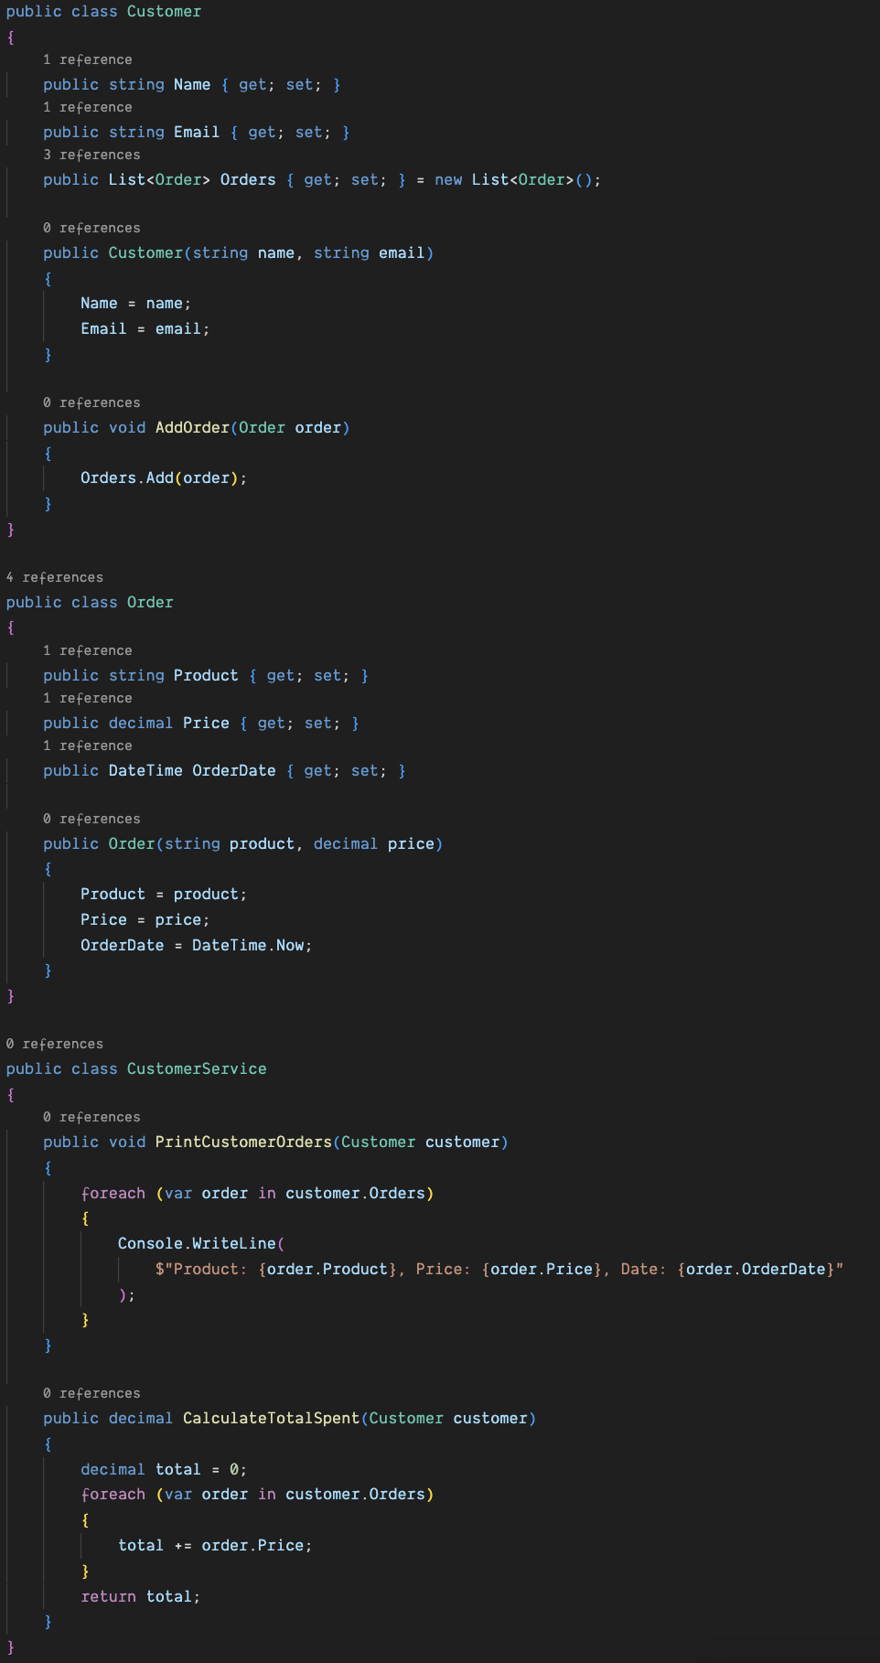
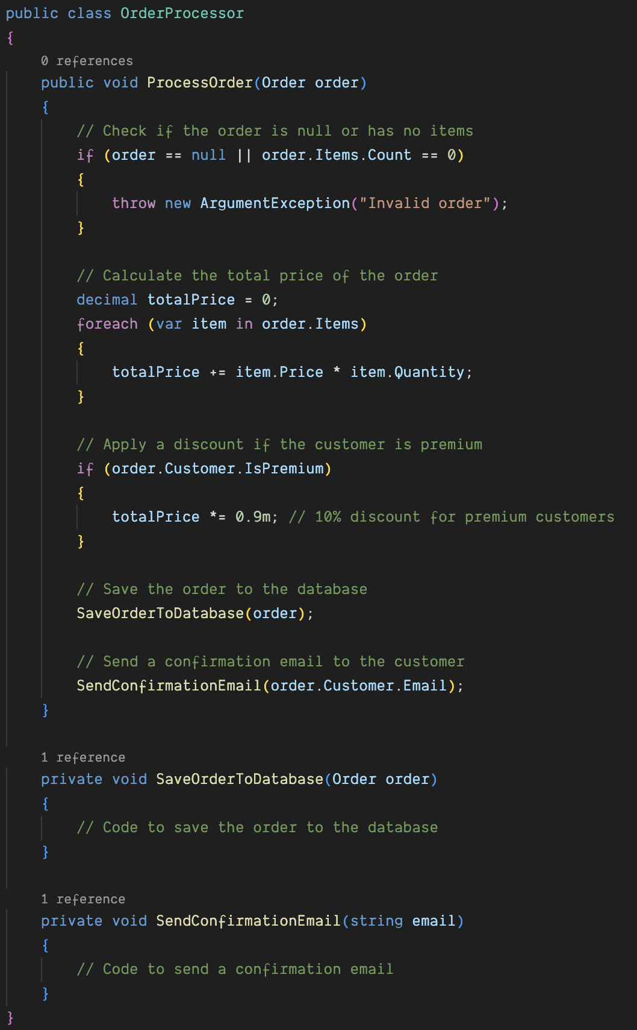
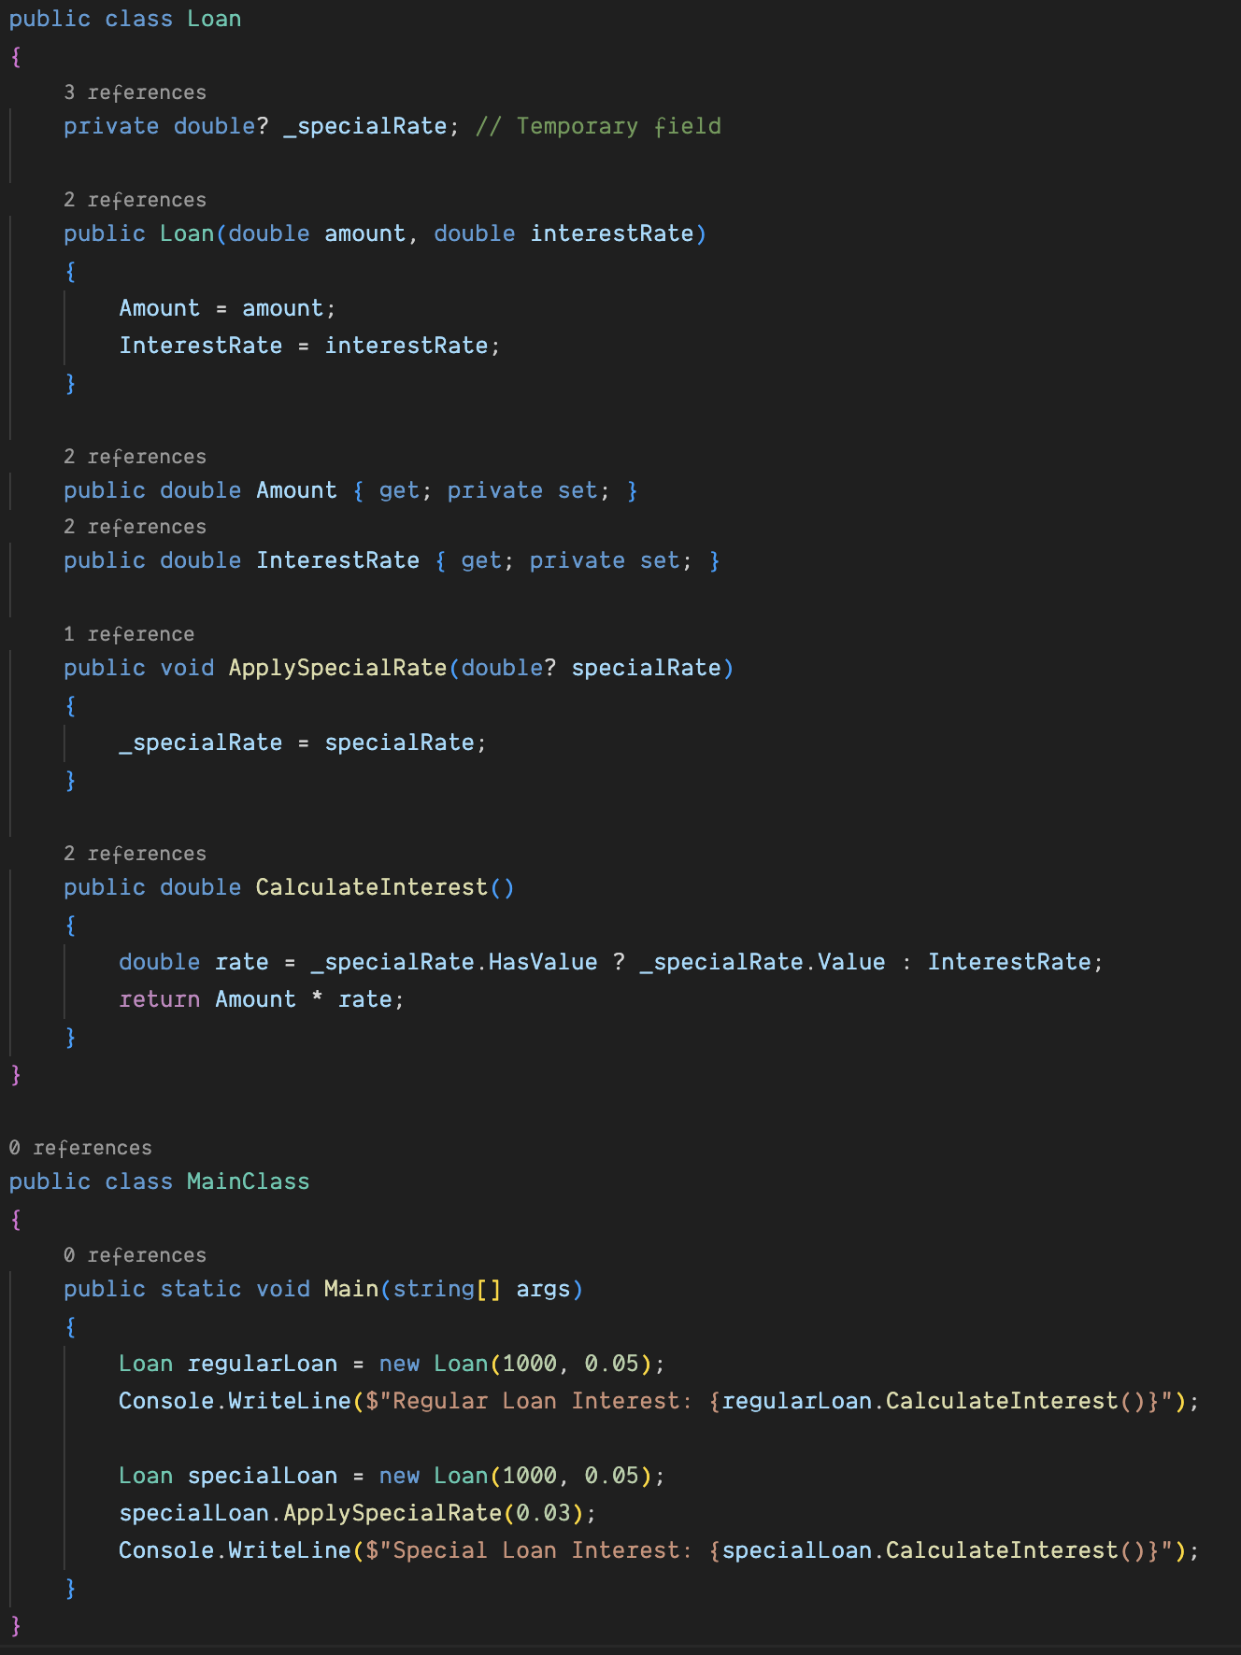
Temporary Field and Other Code Smells
Temporary Field
An instance variable that is set only in certain situations
Other Common Code Smells
Comments as deodorant
Inappropriate intimacy
Notes:
## Example of Temporary Field
In this example, the `Loan` class has a temporary field `_specialRate` that is only used when a special rate is applied. This field complicates the class because it introduces conditional logic in the `CalculateInterest` method to handle whether `_specialRate` is set.
A more straightforward approach could involve using a method parameter or a different class for loans with special rates.
## Example of Comments as Deodorant
In this example, comments are used to explain what each section of the `ProcessOrder` method does. While the comments provide clarity, the code itself could be refactored to be self-explanatory, reducing the need for comments.
## Example of Inappropriate Intimacy
Inappropriate Intimacy is a code smell where two classes are too familiar with each other's internal details. This can lead to a high degree of coupling, making the code difficult to maintain and change.
## Example of Inappropriate Intimacy
In this example, the `CustomerService` class accesses the `Orders` property of the `Customer` class directly, which means it knows too much about the internal structure of `Customer`. This is a sign of Inappropriate Intimacy.
To address this, you could encapsulate the behavior within the `Customer` class itself, or use methods to expose necessary information in a controlled way.

Slide 15

The Boy Scout Rule
Always leave the code cleaner than you found it.
Notes:
(10:00 - 10:07) 7 minutes
**One Sentence Summary**
- "Introduce the Boy Scout Rule, explaining its significance in maintaining code quality through small, continuous improvements."
- Emphasize the importance of continuous improvement in code quality
**Detailed Notes**:
- **Objective**:
- **Explanation**:
- Emphasize the importance of continuously improving code quality by making small, incremental changes.
- **Example**:
- "The Boy Scout Rule encourages us to leave the codebase better than we found it, ensuring long-term maintainability and reducing technical debt."
- **Concept**:
- **The Boy Scout Rule: "Always leave the code cleaner than you found it."**:
- **Explanation**:
- This rule advocates for making small improvements to the code whenever we make changes, even if it's not related to the immediate task.
- **Example**:
- "If you notice a poorly named variable while fixing a bug, take a moment to rename it to something more meaningful, even if it's not directly related to the bug fix."
- **Importance of Small, Incremental Improvements to Prevent Code Decay**:
- **Explanation**:
- Small, consistent improvements prevent the code from deteriorating over time, making it easier to maintain and extend.
- **Example**:
- "Regularly refactoring small parts of the code can prevent the accumulation of technical debt and keep the codebase clean and manageable."
- **Discussion**:
- **Examples of Applying the Boy Scout Rule in Daily Coding Practices**:
- **Explanation**:
- Share practical examples of how to apply the Boy Scout Rule in daily development tasks.
- **Example**:
- "While working on a feature, if you encounter a method that could be broken down into smaller, more focused methods, take the time to refactor it. This improves readability and maintainability."
- **Benefits of Consistent, Small Refactorings Over Time**:
- **Explanation**:
- Highlight the long-term benefits of applying the Boy Scout Rule, such as reduced technical debt and improved code quality.
- **Example**:
- "Over time, consistent application of the Boy Scout Rule leads to a cleaner, more maintainable codebase. This reduces the risk of bugs and makes it easier to add new features."
**Background Information**:
- **The Boy Scout Rule**:
- Coined by Robert C. Martin (Uncle Bob), the Boy Scout Rule is a principle that encourages developers to continuously improve the code they work on. It's based on the idea that leaving the codebase slightly better with each change prevents long-term code rot and technical debt.
**Example**:
- **Real-world Scenario**:
- "In a project, we noticed that applying the Boy Scout Rule consistently helped us maintain a high-quality codebase. Small changes like renaming variables, breaking down large methods, and improving comments made a significant difference over time. This practice reduced the occurrence of bugs and made the code easier to understand and modify."

Slide 16

Make the Change Easy, Then Make the Easy Change
Refactor the code to make it easier to implement changes
Implement the actual change after preparing the code
Notes:
(10:07 - 10:15) 8 minutes
**One Sentence Summary**
- "Introduce the two-step approach of 'Make the Change Easy, Then Make the Easy Change,' explaining how it simplifies refactoring and feature addition."
**Detailed Notes**:
- **Objective**:
- **Explanation**:
- Emphasize the importance of preparing the codebase before implementing new changes or features. This two-step approach ensures changes are easier and less risky to implement.
- **Example**:
- "Before adding a new feature, refactor the code to simplify the addition. This preparation step minimizes the risk of introducing bugs."
- **Concept**:
- **"Make the Change Easy": Refactor the Code to Make It Easier to Implement Changes**:
- **Explanation**:
- The first step involves refactoring the existing code to simplify the implementation of new features or changes.
- **Example**:
- "If you need to add a new payment method to a checkout system, first refactor the existing payment processing code to make it more modular and extendable."
- **"Then Make the Easy Change": Implement the Actual Change After Preparing the Code**:
- **Explanation**:
- Once the code is prepared and refactored, the actual change or feature addition can be implemented more easily and with fewer risks.
- **Example**:
- "After refactoring the payment processing code, adding the new payment method becomes a straightforward task, reducing the likelihood of errors."
- **Discussion**:
- **Examples of Breaking Down Complex Changes into Manageable Steps**:
- **Explanation**:
- Share practical examples of how to break down complex changes into smaller, more manageable steps.
- **Example**:
- "When implementing a new feature that requires significant changes to the database schema, start by refactoring the data access layer to decouple it from the rest of the application. This makes the subsequent schema changes easier to manage."
- **How This Approach Minimizes Risks and Improves Code Maintainability**:
- **Explanation**:
- Highlight the benefits of this approach, such as reduced risk of introducing bugs and improved maintainability of the codebase.
- **Example**:
- "By making the codebase more modular and decoupled before implementing changes, you reduce the risk of cascading failures and make future maintenance easier."
**Background Information**:
- **Make the Change Easy, Then Make the Easy Change**:
- This principle is a key part of effective refactoring and agile development. It emphasizes the importance of preparing the codebase for changes to ensure that the actual changes are easy and low-risk to implement.
**Example**:
- **Real-world Scenario**:
- "In a project, we needed to add a new reporting feature that required accessing data from multiple sources. First, we refactored the data access layer to be more flexible and modular. This made it much easier to integrate the new data sources and implement the reporting feature without disrupting the existing codebase."

Slide 17

Introduction to the Gilded Rose Kata
Overview of the problem
Maintain and refactor a piece of legacy code while adding new features
Notes:
(10:15 - 10:30) 15 minutes
#### Bullet Points:
- Overview of the Gilded Rose problem
- Maintain and refactor a piece of legacy code while adding new features
- Emphasis on understanding and improving existing code without breaking it
- Importance of this kata for practicing TDD and refactoring techniques
#### Presenter Notes:
**One Sentence Summary**
- "Introduce the Gilded Rose Kata, explaining its significance in practicing TDD and refactoring techniques while working with legacy code."
**Detailed Notes**:
- **Overview of the Gilded Rose Problem**:
- **Explanation**:
- The Gilded Rose Kata is a common coding exercise that involves maintaining and refactoring a piece of legacy code while adding new features. It simulates a real-world scenario where developers must improve existing code without introducing bugs.
- **Example**:
- "The Gilded Rose Kata involves a shop that sells various items, each with specific behaviors as they age. Your task is to add new functionality while ensuring the existing code continues to work correctly."
- **Emphasis on Understanding and Improving Existing Code Without Breaking It**:
- **Explanation**:
- The kata emphasizes the importance of thoroughly understanding the existing codebase before making changes. This includes identifying potential areas for improvement and ensuring that new features do not break existing functionality.
- **Example**:
- "Before adding new items with special behaviors, you need to understand how the current items are processed and ensure your changes do not disrupt this processing."
- **Importance of This Kata for Practicing TDD and Refactoring Techniques**:
- **Explanation**:
- The Gilded Rose Kata is valuable for practicing TDD because it requires writing tests for existing code and new features. It also provides an opportunity to apply refactoring techniques to improve code quality.
- **Example**:
- "By writing tests for the existing functionality, you can confidently refactor the code and add new features, knowing that your tests will catch any issues introduced by the changes."
**Background Information**:
- **The Gilded Rose Kata**:
- The Gilded Rose Kata was created by Terry Hughes and popularized by Emily Bache. It's a well-known exercise in the software development community for practicing refactoring and adding features to a legacy codebase.
- The exercise helps developers improve their skills in understanding and modifying existing code, writing tests, and applying TDD principles.
**Example**:
- **Real-world Scenario**:
- "In a project, we had to add new product types to an existing e-commerce system. Before making any changes, we wrote tests for the current functionality to ensure we understood how the system worked. This allowed us to confidently refactor the code and add new features without introducing bugs."

Slide 18

Practical Exercise: Gilded Rose Kata with TDD and AI Tools
Notes:
(10:30 - 11:30) 1 hour
**One Sentence Summary**
- "Guide participants through a practical exercise of the Gilded Rose Kata using TDD and AI tools, emphasizing hands-on experience with refactoring and improving legacy code."
- Step 1: Analyze Existing Code
- Review current state of the Gilded Rose codebase
- Identify areas that need improvement and potential refactoring opportunities
- Step 2: Write the First Test (Red)
- Use GitHub Copilot to generate initial test cases for existing functionality
- Verify the generated code and ensure it aligns with TDD principles
- Step 3: Make the Test Pass (Green)
- Use Copilot to generate the minimal code needed to pass the test
- Discuss the manual verification of the code's correctness
- Step 4: Refactor
- Refactor the code with the assistance of Copilot to improve readability and maintainability
- Ensure the test still passes after refactoring
**Detailed Notes**:
- **Step 1: Analyze Existing Code (10:30 - 10:45)**:
- **Explanation**:
- Begin by reviewing the current state of the Gilded Rose codebase. This involves understanding how the existing code works, identifying any code smells, and pinpointing areas that need improvement.
- **Example**:
- "Open the Gilded Rose codebase and walk through the existing methods and classes. Discuss any immediate observations regarding potential improvements and refactoring opportunities."
- **Activity**:
- Ask participants to note down their observations and identify at least two areas that could benefit from refactoring.
- **Step 2: Write the First Test (Red) (10:45 - 11:00)**:
- **Explanation**:
- Use GitHub Copilot to assist in generating initial test cases for the existing functionality of the Gilded Rose application. Ensure that these tests align with TDD principles by starting with a failing test.
- **Example**:
- "Generate a test case for the 'Aged Brie' item to ensure its quality increases over time. Use Copilot to help write the test and discuss how to validate the generated code."
- **Activity**:
- Participants write their own initial test cases with the help of Copilot and verify that these tests fail as expected.
- **Step 3: Make the Test Pass (Green) (11:00 - 11:15)**:
- **Explanation**:
- Implement the minimal code required to make the newly written tests pass. Use Copilot to assist with code generation, but ensure manual verification for correctness.
- **Example**:
- "Implement the logic for updating the quality of 'Aged Brie' so that it increases over time. Verify that the test case now passes."
- **Activity**:
- Participants modify the Gilded Rose code to pass their test cases, using Copilot for suggestions and manual checks.
- **Step 4: Refactor (11:15 - 11:30)**:
- **Explanation**:
- Refactor the code to improve readability and maintainability. Use Copilot to assist with refactoring suggestions, ensuring the code adheres to clean code principles and all tests continue to pass.
- **Example**:
- "Refactor the logic for updating item quality into separate methods or classes to improve code structure. Ensure all tests still pass after refactoring."
- **Activity**:
- Participants refactor their Gilded Rose codebase, making improvements based on previous observations and verifying that all tests still pass.
**Background Information**:
- **Gilded Rose Kata**:
- This exercise is a well-known coding kata that involves maintaining and refactoring a piece of legacy code while adding new features. It provides an excellent opportunity to practice TDD, understand existing code, and apply refactoring techniques.
**Example**:
- **Real-world Scenario**:
- "In a real project, maintaining legacy code is a common task. The Gilded Rose Kata simulates this scenario, allowing you to practice writing tests, refactoring, and adding new features without introducing bugs."

Slide 19

Introduction to Design Patterns
A design pattern is a reusable solution to a common problem in software design, providing a template for structuring and solving specific issues efficiently and effectively.
Notes:
(11:30 - 11:35) 5 minutes
**One Sentence Summary**
- "Introduce the concept of design patterns, explaining their importance in creating scalable and maintainable software architectures."
**Detailed Notes**:
- **Overview of Common Design Patterns**:
- **Explanation**:
- Design patterns are typical solutions to common problems in software design. They represent best practices that can be used to structure your code in a way that is more maintainable, scalable, and reusable.
- **Example**:
- "Design patterns provide a shared vocabulary for software developers. Instead of explaining a complex architecture, you can simply refer to it as a 'Factory Pattern' or 'Observer Pattern.'"
- **List of Common Design Patterns**:
- **Singleton**:
- Ensures a class has only one instance and provides a global point of access to it.
- **Example**: "Use a Singleton pattern to manage a shared resource, like a configuration manager."
- **Factory**:
- Creates objects without specifying the exact class to create.
- **Example**: "Use a Factory pattern to create objects based on a condition, such as different types of notifications."
- **Strategy**:
- Defines a family of algorithms, encapsulates each one, and makes them interchangeable.
- **Example**: "Use a Strategy pattern to switch between different data sorting algorithms at runtime."
- **Observer**:
- Defines a one-to-many dependency between objects so that when one object changes state, all its dependents are notified and updated automatically.
- **Example**: "Use an Observer pattern to update UI components in response to data changes."
- **Decorator**:
- Adds responsibilities to objects dynamically.
- **Example**: "Use a Decorator pattern to add functionalities to objects, such as adding scrollbars to a window."
- **Command**:
- Encapsulates a request as an object, thereby allowing for parameterization of clients with queues, requests, and operations.
- **Example**: "Use a Command pattern to handle user actions like undo/redo."
- **Adapter**:
- Allows incompatible interfaces to work together.
- **Example**: "Use an Adapter pattern to make a third-party library's interface compatible with your application."
- **Importance of Using Design Patterns for Scalable and Maintainable Code**:
- **Explanation**:
- Design patterns help in building a robust architecture that can easily adapt to changing requirements. They also promote code reuse and make it easier for developers to communicate ideas.
- **Example**:
- "Implementing design patterns can lead to more scalable and maintainable systems. For instance, using the Observer pattern in a real-time application can simplify the process of updating multiple components in response to a single change."
**Background Information**:
- **Design Patterns**:
- The concept of design patterns was popularized by the "Gang of Four" (Erich Gamma, Richard Helm, Ralph Johnson, and John Vlissides) in their book "Design Patterns: Elements of Reusable Object-Oriented Software." These patterns provide a proven solution to common design problems, facilitating better communication among developers and more efficient problem-solving.
**Example**:
- **Real-world Scenario**:
- "In a project where we needed to support multiple payment methods, we used the Factory pattern to create different payment processors based on the payment type. This approach made it easy to add new payment methods in the future without modifying existing code."

Slide 20
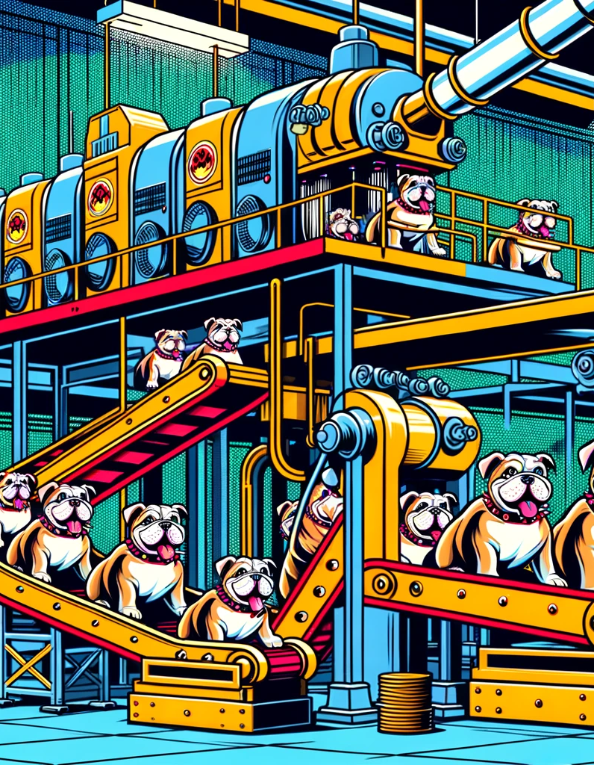
Singleton and Factory Patterns
Singleton
Ensures a class has only one instance and provides a global point of access to it
Factory
Creates objects without specifying the exact class to create
Notes:
(11:35 - 11:40) 5 minutes
**One Sentence Summary**
- "Introduce the Singleton and Factory design patterns, explaining their purposes and providing practical examples of their use."
**Detailed Notes**:
- **Singleton**:
- **Explanation**:
- The Singleton pattern restricts the instantiation of a class to one single instance and provides a global point of access to that instance.
- **Example**:
- "A common use case for the Singleton pattern is managing a configuration manager that should be shared across the entire application. By ensuring only one instance exists, you prevent conflicts and ensure consistent behavior."
- **Refactoring Tips**:
- Ensure thread safety if the Singleton is accessed from multiple threads.
- Use lazy initialization if the Singleton instance is resource-intensive.
- **Factory**:
- **Explanation**:
- The Factory pattern defines an interface for creating an object but lets subclasses alter the type of objects that will be created. It abstracts the instantiation process, allowing the code to remain flexible and extensible.
- **Example**:
- "The Factory pattern is useful for creating different types of notifications, such as email, SMS, and push notifications, based on user preferences. This decouples the client code from the specific classes of notifications."
- **Refactoring Tips**:
- Use the Factory pattern to eliminate direct instantiation of classes in your code.
- Encapsulate the logic of creating objects, making it easier to introduce new types without modifying existing code.
**Background Information**:
- **Singleton Pattern**:
- The Singleton pattern is one of the simplest design patterns and is often used for scenarios where exactly one object is needed to coordinate actions across a system.
- Despite its simplicity, the Singleton pattern can introduce issues if not used carefully, such as difficulties in testing due to its global state and potential for creating hidden dependencies.
- **Factory Pattern**:
- The Factory pattern is a creational design pattern that abstracts the process of object creation, making a system more modular and scalable.
- It promotes the use of polymorphism by relying on common interfaces or abstract classes, making the system easier to extend.
**Example**:
- **Real-world Scenario for Singleton**:
- "In a logging system, a Singleton logger ensures that all parts of the application log through the same instance, maintaining consistency and avoiding the overhead of creating multiple logger instances."
- **Real-world Scenario for Factory**:
- "In an application that supports multiple file formats, a Factory pattern can be used to create parsers for each format (XML, JSON, CSV) based on the file type, simplifying the addition of new formats in the future."

Slide 21
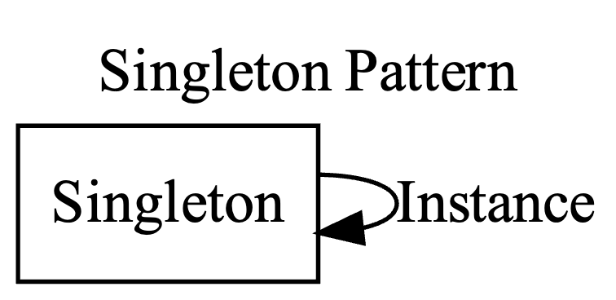
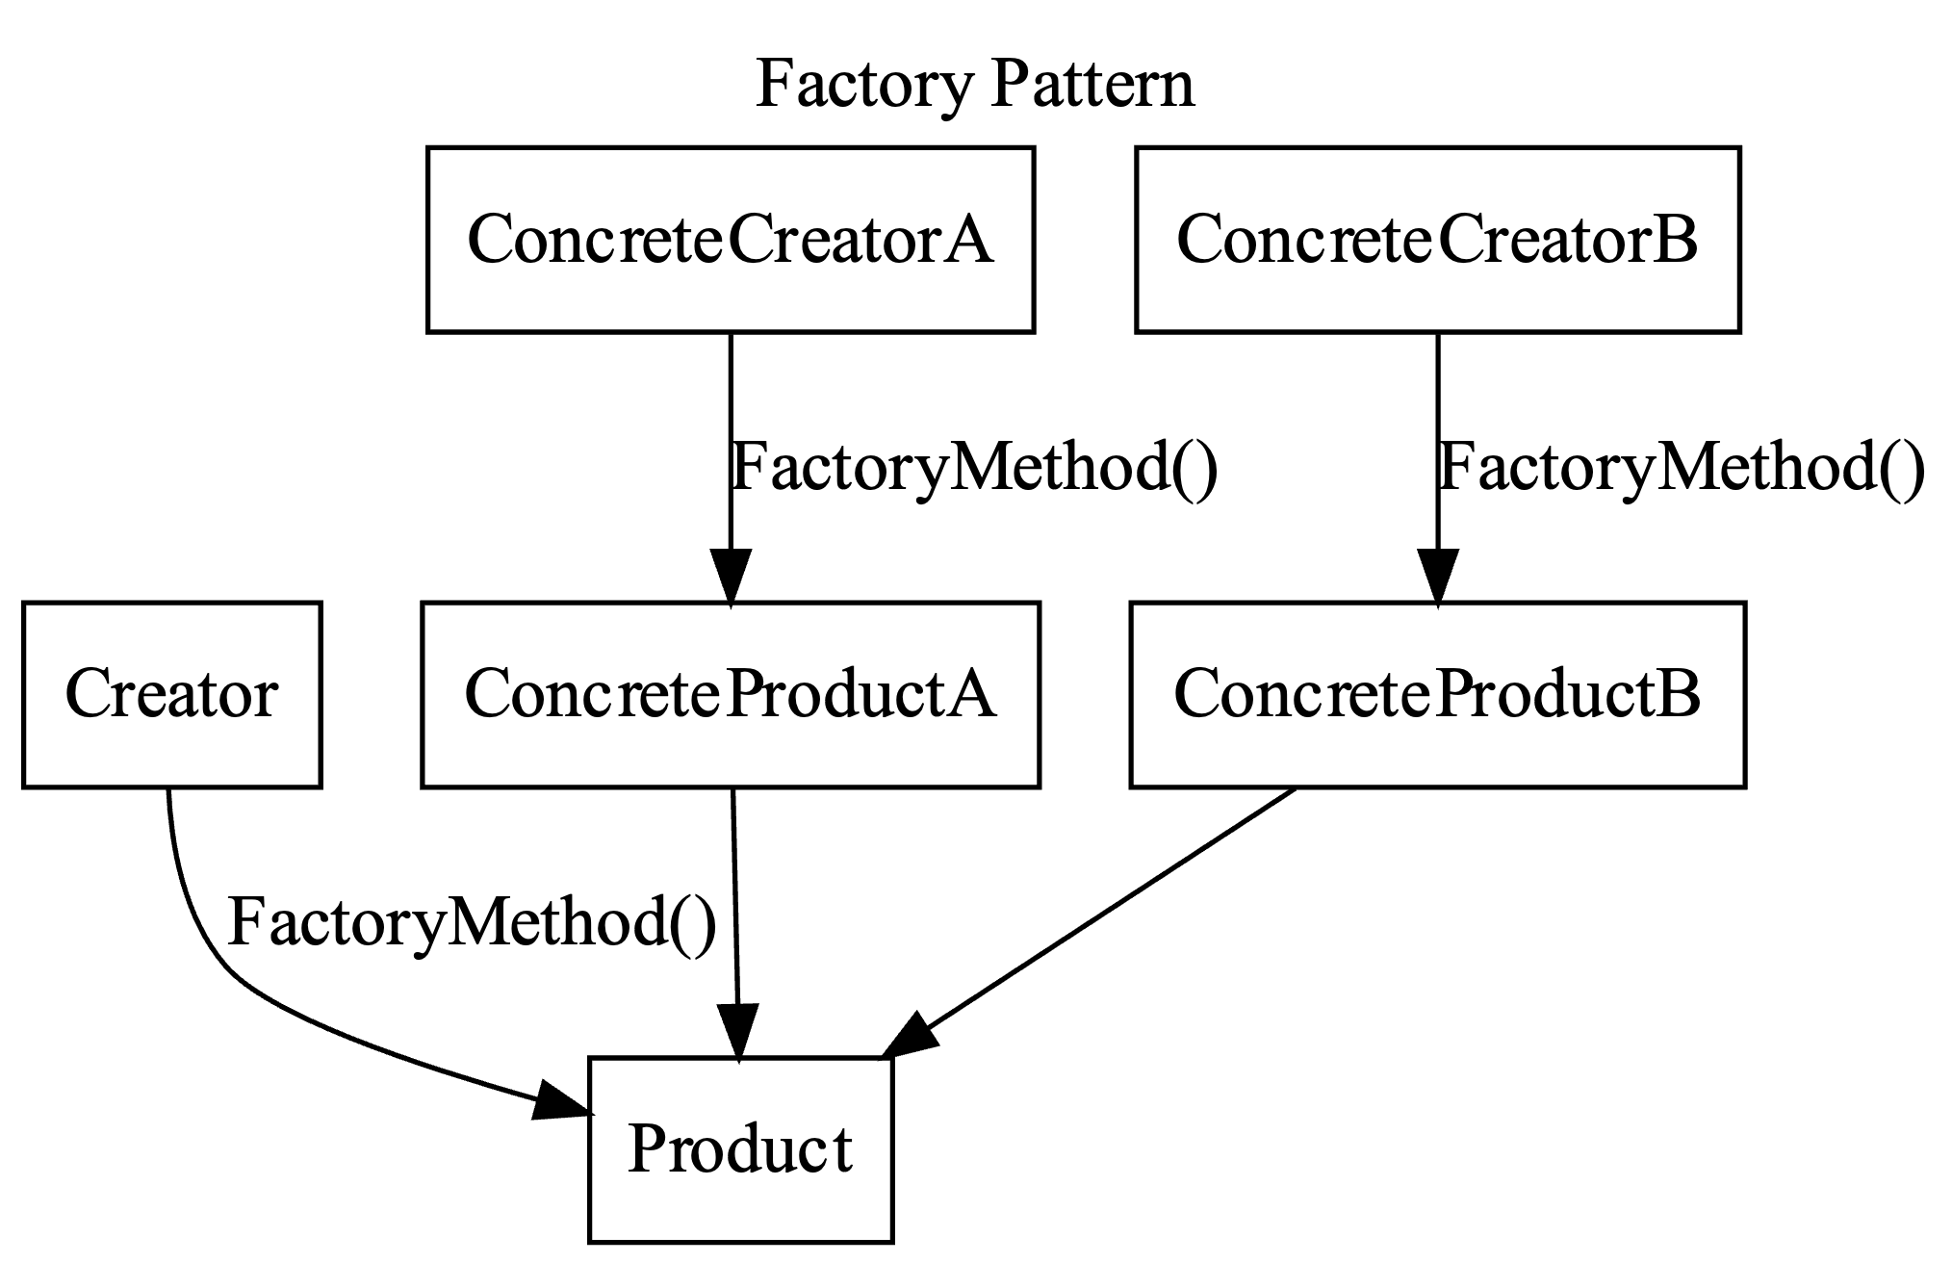
Singleton and Factory Patterns
Notes:
## Singleton Pattern
- The `Singleton` class has a single instance represented by the `Instance` property, ensuring only one instance is created.
## Factory Pattern
- `Creator` is an abstract class that declares the factory method `FactoryMethod()`, which returns a `Product` object.
- `ConcreteCreatorA` and `ConcreteCreatorB` are concrete subclasses of `Creator` that override the `FactoryMethod()` to return instances of `ConcreteProductA` and `ConcreteProductB`, respectively.
- `Product` is an abstract class, and `ConcreteProductA` and `ConcreteProductB` are concrete implementations of `Product`.

Slide 22

Strategy and Observer Patterns
Strategy
Defines a family of algorithms, encapsulates each one, and makes them interchangeable
Observer
Defines a one-to-many dependency between objects so that when one object changes state, all its dependents are notified and updated automatically
Notes:
(11:40 - 11:45) 5 minutes
**One Sentence Summary**
- "Introduce the Strategy and Observer design patterns, explaining their purposes and providing practical examples of their use."
**Detailed Notes**:
- **Strategy**:
- **Explanation**:
- The Strategy pattern allows you to define a family of algorithms, encapsulate each one, and make them interchangeable. This pattern lets the algorithm vary independently from clients that use it.
- **Example**:
- "In a data processing application, you might use the Strategy pattern to switch between different sorting algorithms based on the size and nature of the dataset. For small datasets, you could use a simple bubble sort, while for larger datasets, you could switch to a more efficient quicksort."
- **Refactoring Tips**:
- Define a common interface for all strategies.
- Encapsulate the algorithm in separate classes, allowing the client to choose and switch between them dynamically.
- **Observer**:
- **Explanation**:
- The Observer pattern defines a one-to-many dependency between objects. When one object changes state, all its dependents are notified and updated automatically. This is useful for implementing distributed event-handling systems.
- **Example**:
- "In a GUI application, you might use the Observer pattern to update UI components when the underlying data model changes. For instance, if a user updates their profile information, all relevant UI elements are notified and updated accordingly."
- **Refactoring Tips**:
- Define a subject interface for adding, removing, and notifying observers.
- Ensure that observers implement a common interface to handle updates.
**Background Information**:
- **Strategy Pattern**:
- The Strategy pattern is a behavioral design pattern that promotes the use of interchangeable algorithms. It is particularly useful for scenarios where you need to switch between different methods of executing a task without changing the client code.
- This pattern adheres to the Open/Closed Principle, as new strategies can be added without modifying the existing code.
- **Observer Pattern**:
- The Observer pattern is also a behavioral design pattern that facilitates communication between objects in a loosely coupled manner. It is commonly used in event-driven programming to notify multiple objects of state changes.
- This pattern is useful for implementing a publish-subscribe mechanism, where subjects can notify multiple observers about changes.
**Example**:
- **Real-world Scenario for Strategy**:
- "In a payment processing system, you can use the Strategy pattern to switch between different payment gateways based on the user's preference or availability of the gateway. This allows the system to easily integrate new payment methods in the future."
- **Real-world Scenario for Observer**:
- "In a stock trading application, the Observer pattern can be used to update the user interface with real-time stock price changes. The stock data acts as the subject, and various UI components act as observers that get updated whenever the stock prices change."

Slide 23
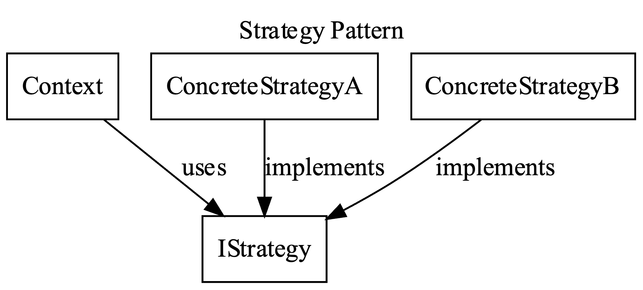
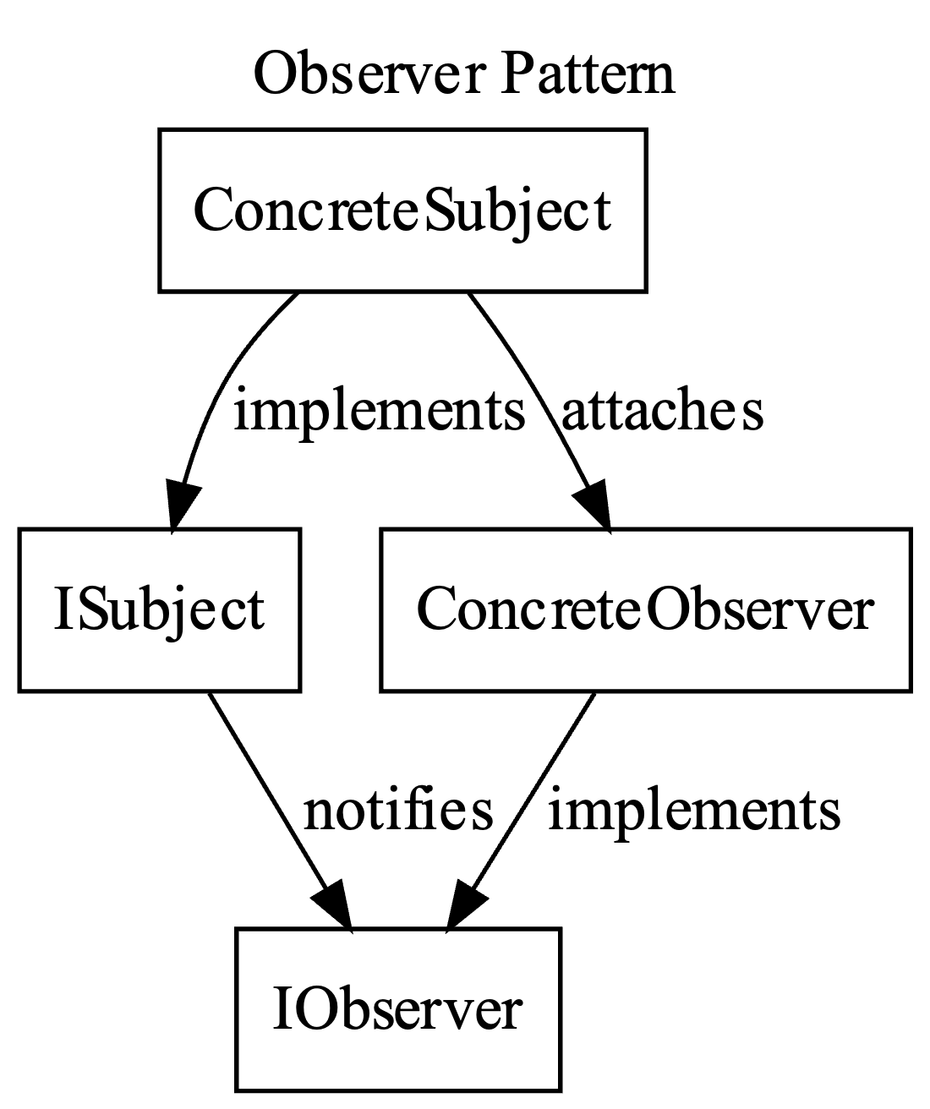
Strategy and Observer Patterns
Notes:
## Strategy Pattern
- `IStrategy` is an interface that defines the strategy algorithm.
- `ConcreteStrategyA` and `ConcreteStrategyB` are concrete implementations of the `IStrategy` interface.
- `Context` class uses a `IStrategy` object to execute the strategy algorithm. It can change the strategy dynamically at runtime.
## Observer Pattern
- `ISubject` is the interface for the subject that defines methods for attaching, detaching, and notifying observers.
- `ConcreteSubject` implements `ISubject` and maintains the state of interest to observers. It notifies observers of any state changes.
- `IObserver` is the interface for observers, defining the `Update` method.
- `ConcreteObserver` implements `IObserver` and updates its state in response to notifications from the subject.

Slide 24
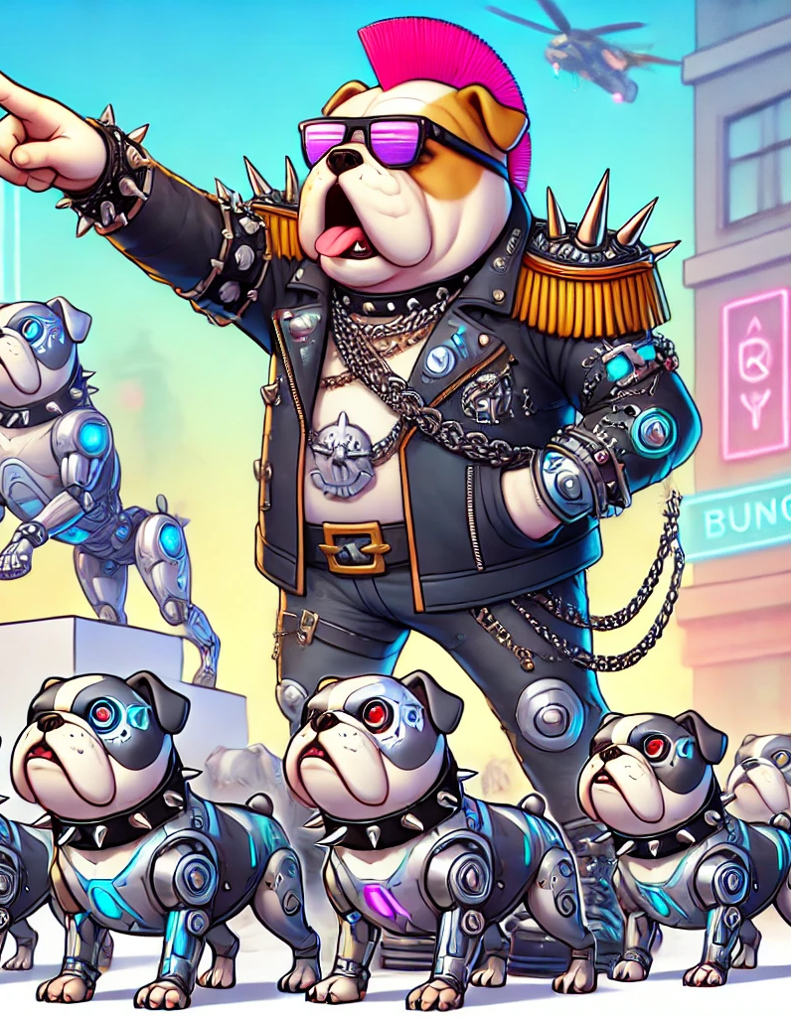
Decorator and Command Patterns
Decorator
Adds responsibilities to objects dynamically
Command
Encapsulates a request as an object, thereby allowing for parameterization of clients with queues, requests, and operations
Notes:
(11:45 - 11:50) 5 minutes
**One Sentence Summary**
- "Introduce the Decorator and Command design patterns, explaining their purposes and providing practical examples of their use."
**Detailed Notes**:
- **Decorator**:
- **Explanation**:
- The Decorator pattern allows behavior to be added to individual objects, dynamically, without affecting the behavior of other objects from the same class.
- **Example**:
- "In a GUI framework, the Decorator pattern can be used to add scrollbars to a window or borders to a text field. Instead of creating a new subclass for each combination of features, decorators can be added to existing classes at runtime."
- **Refactoring Tips**:
- Ensure that decorators implement the same interface as the objects they decorate.
- Use composition to add behavior to objects without modifying their structure.
- **Command**:
- **Explanation**:
- The Command pattern encapsulates a request as an object, thereby allowing for parameterization of clients with queues, requests, and operations. It decouples the sender of a request from its receiver.
- **Example**:
- "In an application with undo/redo functionality, each action the user can perform (like typing text, deleting a line, or applying a style) can be represented as a command. These commands can be stored in a history list and executed, undone, or redone as needed."
- **Refactoring Tips**:
- Create a command interface with an execute method.
- Implement concrete command classes for each type of request.
- Use a command invoker to handle the execution of commands.
**Background Information**:
- **Decorator Pattern**:
- The Decorator pattern is a structural pattern that provides a flexible alternative to subclassing for extending functionality. It is useful for adhering to the Open/Closed Principle, as it allows behavior to be extended without modifying existing code.
- **Command Pattern**:
- The Command pattern is a behavioral pattern that turns a request into a stand-alone object that contains all information about the request. This is useful for implementing operations such as logging, undo/redo, and transactional behaviors.
**Example**:
- **Real-world Scenario for Decorator**:
- "In a text editing application, you might use the Decorator pattern to add different styles to text components. For example, you can add bold, italic, and underline styles to a text component dynamically, based on user actions."
- **Real-world Scenario for Command**:
- "In a graphic design application, user actions like drawing, resizing, and rotating objects can be encapsulated as commands. This allows the application to support complex undo/redo functionality, giving users the flexibility to revert and reapply actions as needed."

Slide 25
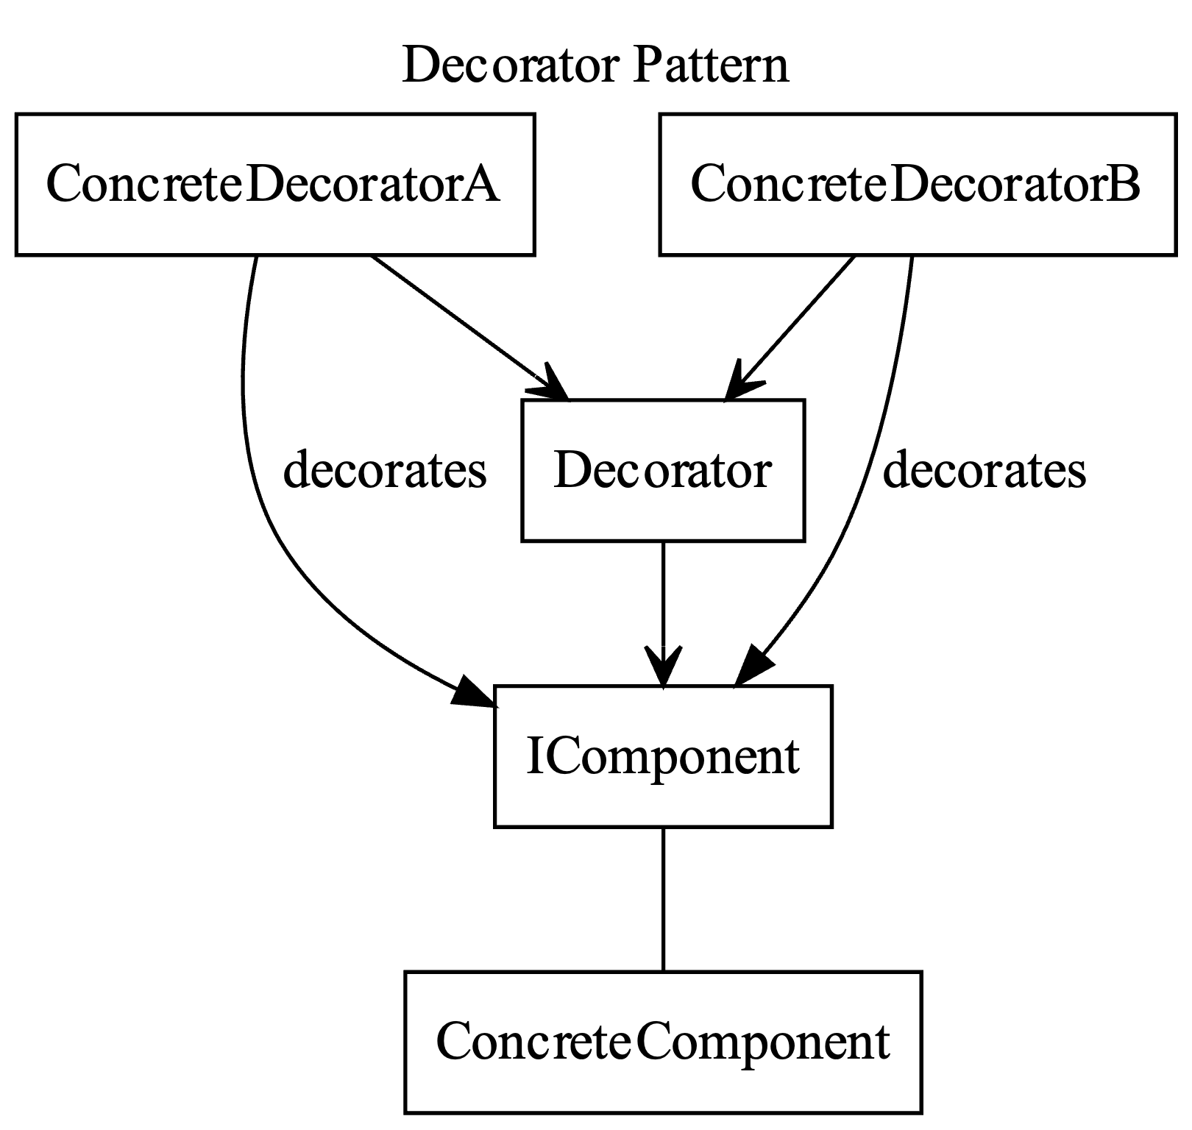
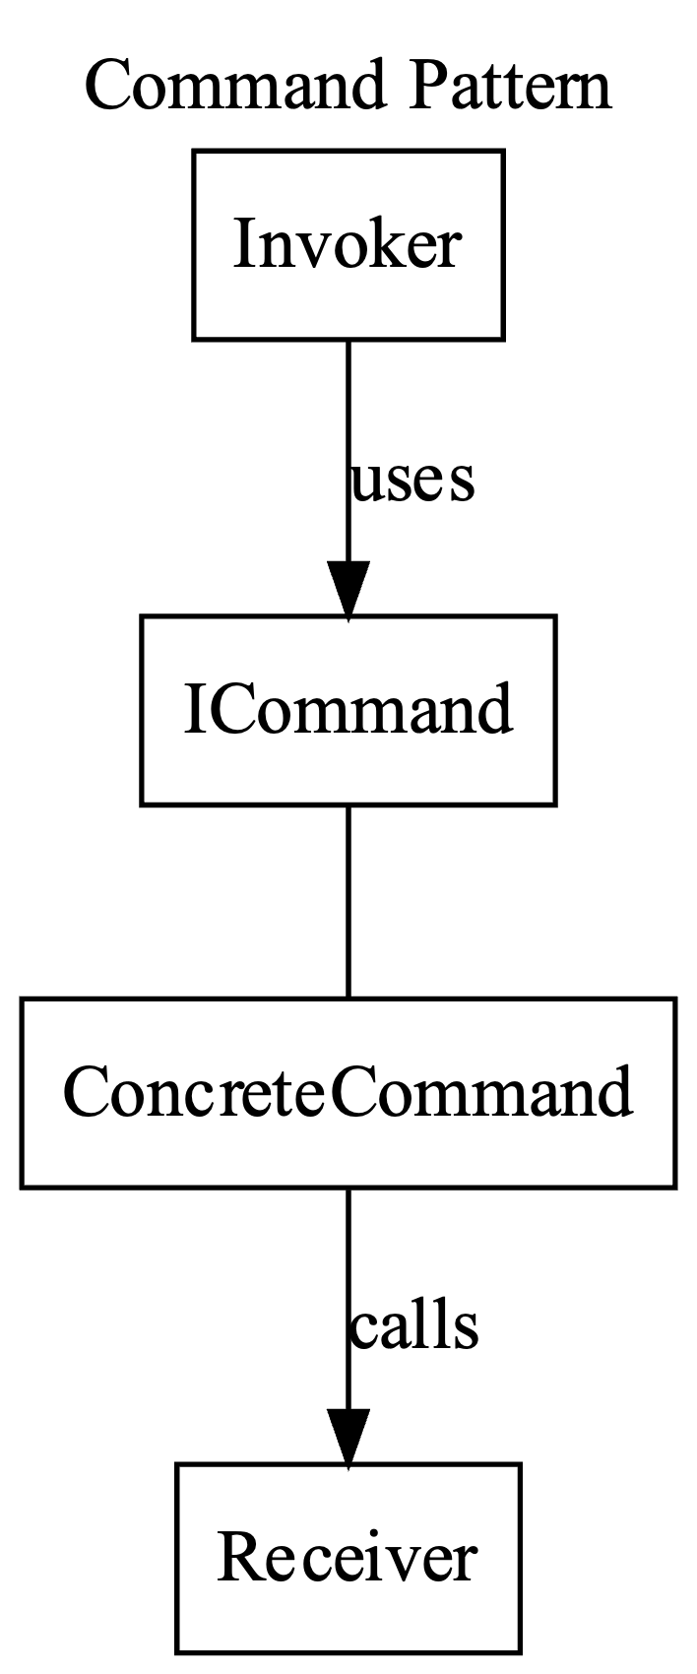
Decorator and Command Patterns
Notes:
## Decorator Pattern
- `IComponent` is the component interface.
- `ConcreteComponent` implements `IComponent`.
- `Decorator` is an abstract class that implements `IComponent` and holds a reference to an `IComponent` object.
- `ConcreteDecoratorA` and `ConcreteDecoratorB` are concrete decorators that extend the functionality of the component by adding behaviors.
## Command Pattern
- `ICommand` is the command interface.
- `ConcreteCommand` implements `ICommand` and holds a reference to `Receiver`.
- `Receiver` is the class that performs the actual action.
- `Invoker` holds a command and can execute the command by calling its `Execute` method.

Slide 26

Adapter and Other Patterns
Adapter
Allows incompatible interfaces to work together
Other useful patterns:
Facade
Proxy
Iterator
Composite
Notes:
(11:50 - 12:00) – 10 minutes
**One Sentence Summary**
- "Introduce the Adapter pattern and briefly overview other useful design patterns, explaining their purposes and providing practical examples."
**Detailed Notes**:
- **Adapter**:
- **Explanation**:
- The Adapter pattern allows objects with incompatible interfaces to work together by providing a wrapper that translates the interface of one class into an interface expected by the clients.
- **Example**:
- "If your application uses a logging framework with a different interface than a third-party library, you can create an adapter to make the third-party library compatible with your application's logging framework."
- **Refactoring Tips**:
- Implement an adapter class that wraps the existing class and translates the interface.
- Ensure the adapter class implements the expected interface, facilitating smooth integration.
- **Other Useful Patterns**:
- **Facade**:
- **Explanation**:
- The Facade pattern provides a simplified interface to a complex subsystem, making it easier to use.
- **Example**:
- "In a home automation system, a Facade can provide a simple interface to control multiple subsystems like lighting, heating, and security."
- **Proxy**:
- **Explanation**:
- The Proxy pattern provides a surrogate or placeholder for another object to control access to it.
- **Example**:
- "In a network application, a proxy can control access to a remote service, providing caching and access control."
- **Iterator**:
- **Explanation**:
- The Iterator pattern provides a way to access the elements of an aggregate object sequentially without exposing its underlying representation.
- **Example**:
- "In a collection framework, an iterator allows you to traverse a list or set without needing to know its internal structure."
- **Composite**:
- **Explanation**:
- The Composite pattern allows you to compose objects into tree structures to represent part-whole hierarchies. It enables clients to treat individual objects and compositions of objects uniformly.
- **Example**:
- "In a graphical user interface, you can use the Composite pattern to treat individual widgets and compositions of widgets uniformly."
**Background Information**:
- **Adapter Pattern**:
- The Adapter pattern is a structural pattern that helps to make classes work together that otherwise couldn't because of incompatible interfaces. It is often used when integrating third-party libraries or legacy systems.
- **Other Patterns**:
- **Facade**: Often used to provide a simple interface to a complex subsystem, making the subsystem easier to use and understand.
- **Proxy**: Commonly used in situations where an object is expensive to create, or where you want to control access to the object.
- **Iterator**: Widely used in collection frameworks to provide a standard way to traverse elements without exposing the underlying structure.
- **Composite**: Useful in scenarios where you want to treat individual objects and compositions of objects uniformly, such as in hierarchical data structures.
**Example**:
- **Real-world Scenario for Adapter**:
- "In a payment processing system, if you switch to a new payment gateway with a different interface, you can use an adapter to make the new gateway compatible with your existing code, ensuring a smooth transition."
- **Real-world Scenario for Other Patterns**:
- **Facade**: "In a library management system, a Facade can provide a simple interface for checking out and returning books, hiding the complexity of interacting with multiple subsystems like inventory, user accounts, and notifications."
- **Proxy**: "In a security system, a proxy can control access to sensitive resources, providing logging and access control features."
- **Iterator**: "In a music playlist application, an iterator can allow users to browse through songs without needing to know the details of how the playlist is stored."
- **Composite**: "In a drawing application, you can use the Composite pattern to manage complex drawings made up of simple shapes, allowing you to treat both simple and complex drawings uniformly."

Slide 27
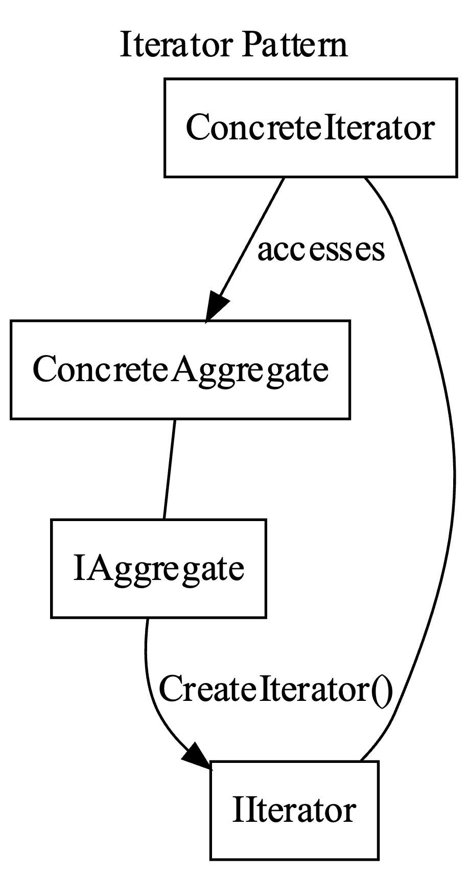
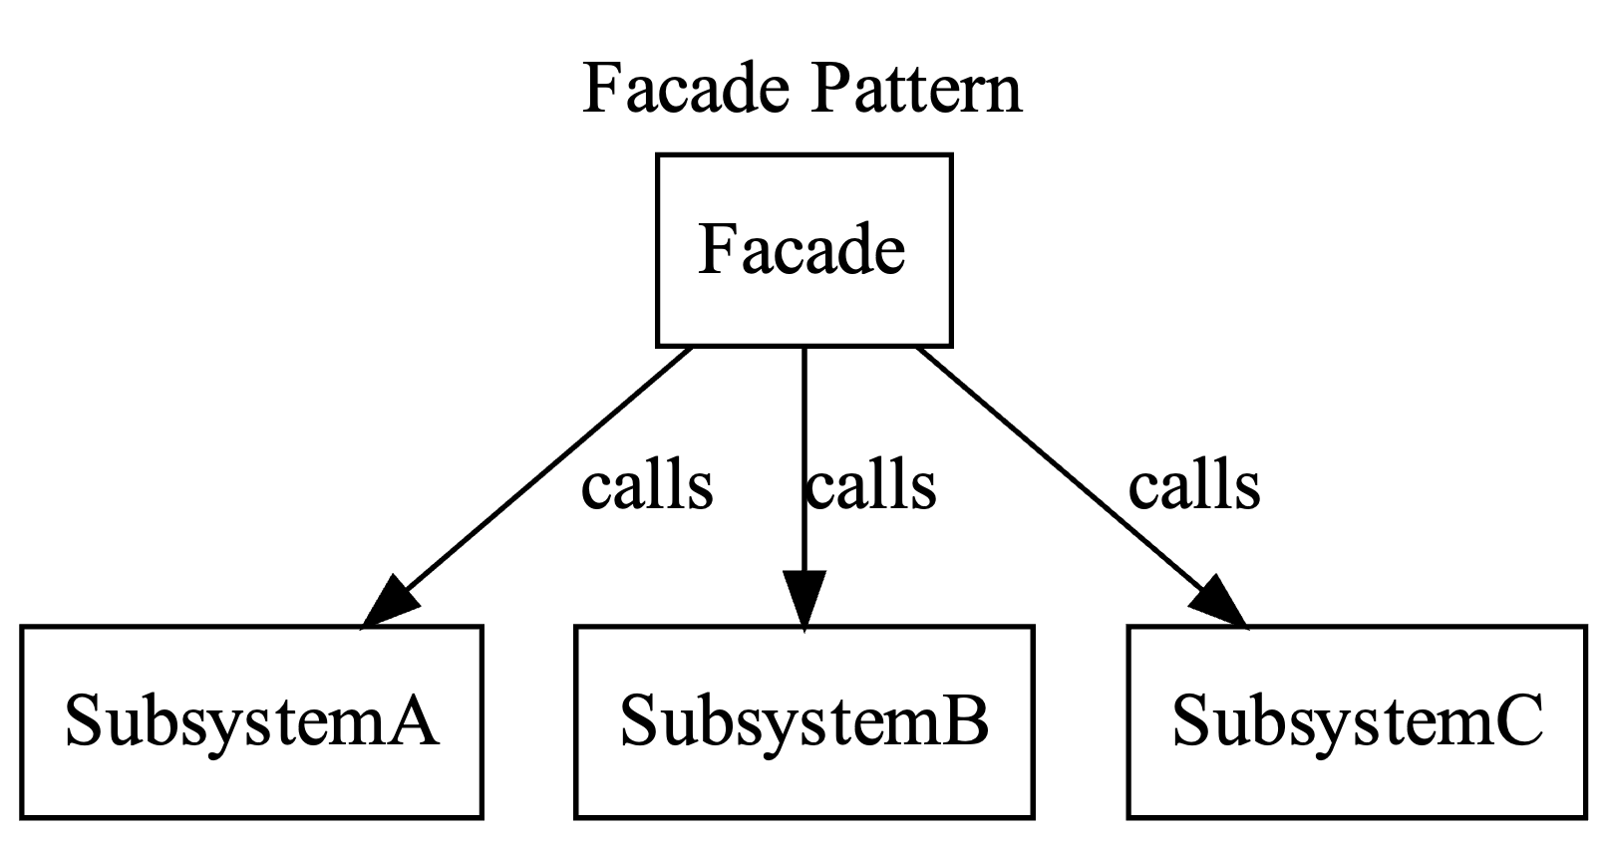
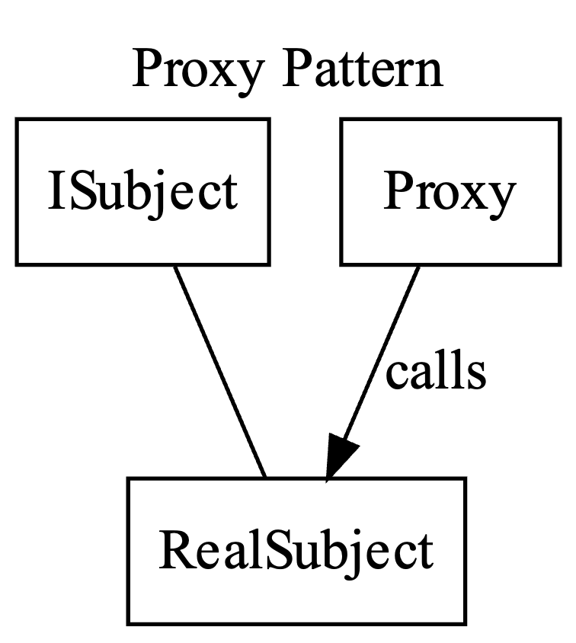
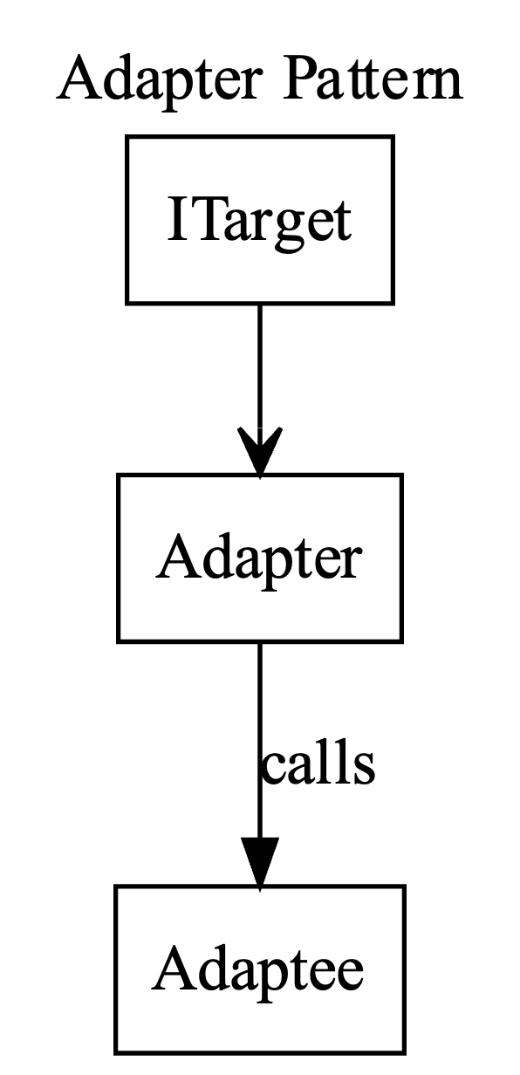
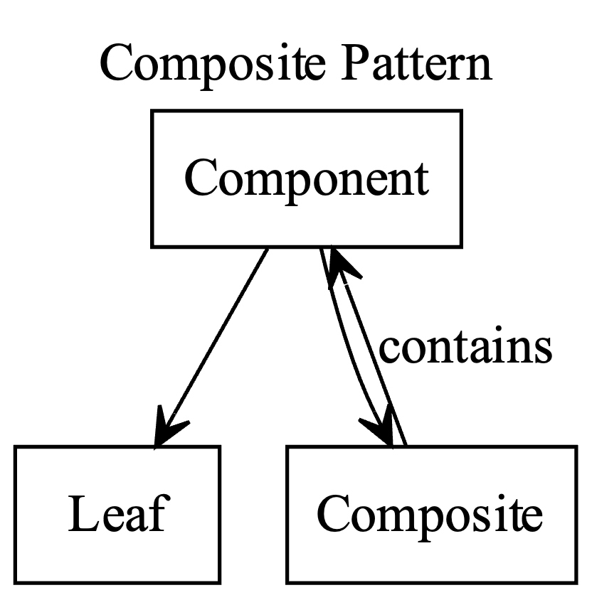
Adapter and Other Patterns
Notes:
## Adapter Pattern
- `ITarget` is the target interface expected by the client.
- `Adaptee` is the class that needs to be adapted.
- `Adapter` implements `ITarget` and holds a reference to `Adaptee`. It translates the `Request` call to `SpecificRequest`.
## Facade Pattern
- `SubsystemA`, `SubsystemB`, and `SubsystemC` are the complex subsystems with their own operations.
- `Facade` provides a simplified interface to these subsystems, calling their operations to perform higher-level operations `Operation1` and `Operation2`.
## Proxy Pattern
- `ISubject` is the common interface for both the `RealSubject` and the `Proxy`.
- `RealSubject` implements the `ISubject` interface and contains the real logic.
- `Proxy` also implements the `ISubject` interface and controls access to the `RealSubject`, adding additional behavior such as logging.
## Iterator Pattern
- `IAggregate` is the interface for the aggregate, which declares the `CreateIterator` method.
- `ConcreteAggregate` implements `IAggregate` and holds the collection of items.
- `IIterator` is the interface for the iterator, which declares methods for iteration (`HasNext`, `Next`).
- `ConcreteIterator` implements `IIterator` and provides the logic for iterating over the `ConcreteAggregate`.
## Composite Pattern
- `Component` is the abstract class that defines the interface for objects in the composition.
- `Leaf` is a class that represents leaf objects in the composition. A leaf has no children.
- `Composite` is a class that represents composite objects. A composite can have children, which can be either `Leaf` objects or other `Composite` objects.
- The `Composite` class contains and manages child components, implementing the `Add`, `Remove`, and `Display` methods.

Slide 28

Wrap-Up and Q&A
Summarize key takeaways
Open floor for questions
Preview of the afternoon session
Notes:
(12:00) Up to when people want to take lunch
**One Sentence Summary**
- "Summarize the key points from the morning session, address any questions, and preview the upcoming afternoon session."
**Detailed Notes**:
- **Summarize Key Takeaways from the Morning Session**:
- **Explanation**:
- Recap the main concepts covered in the morning session, highlighting the importance of TDD, design patterns, and the use of AI tools in software development.
- **Example**:
- "We've covered essential TDD practices with the Gilded Rose Kata, explored various design patterns, and seen how AI tools like GitHub Copilot can enhance our coding process."
- **Encourage Continuous Practice and Improvement**:
- **Explanation**:
- Stress the importance of applying what has been learned through continuous practice and seeking improvement.
- **Example**:
- "Remember, the principles and patterns we've discussed today are not just for the classroom. They are tools you can apply in your daily work to improve code quality and efficiency."
- **Open Floor for Questions and Discussions**:
- **Address Any Challenges Faced by Participants**:
- **Explanation**:
- Invite participants to share any difficulties they encountered and provide solutions or further explanations as needed.
- **Example**:
- "Let's discuss any challenges you faced during the exercises. How can we address them, and what additional resources might help?"
- **Provide Solutions and Additional Resources**:
- **Explanation**:
- Offer practical solutions to the issues raised and suggest additional resources for further learning.
- **Example**:
- "If you're struggling with understanding design patterns, I recommend the book 'Design Patterns: Elements of Reusable Object-Oriented Software' by the Gang of Four for deeper insights."
- **Preview of the Afternoon Session**:
- **Explanation**:
- Give a brief overview of what to expect in the afternoon session, building anticipation and preparing participants for the next set of activities.
- **Example**:
- "This afternoon, we'll delve into prompt engineering, build an API application, and explore deployment using GitHub Actions and a free cloud provider. These sessions will build on what we've learned this morning and introduce new, practical skills."
**Background Information**:
- **Wrap-Up and Q&A**:
- This session is crucial for reinforcing learning and ensuring participants have a clear understanding of the material covered. It provides an opportunity to address any uncertainties and prepare for the next set of topics.
**Example**:
- **Real-world Scenario**:
- "In previous workshops, participants found the Q&A session invaluable for clarifying concepts and getting personalized advice. This session aims to ensure everyone is on the same page and ready to tackle the afternoon's challenges with confidence."

